Slide 1
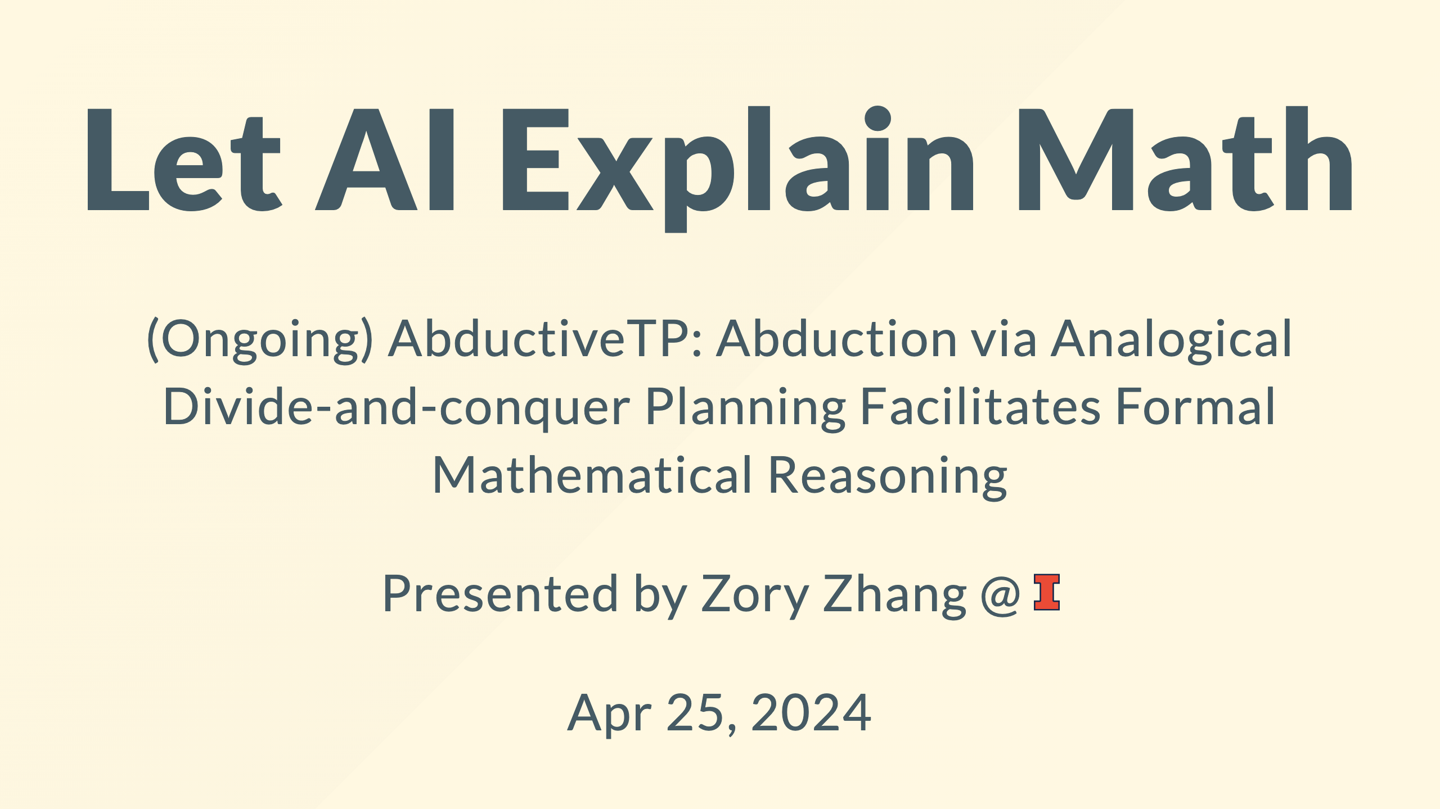
Notes:
https://marp.app/docs https://github.com/rnd195/my-marp-themes/blob/main/beamer.css

Slide 2
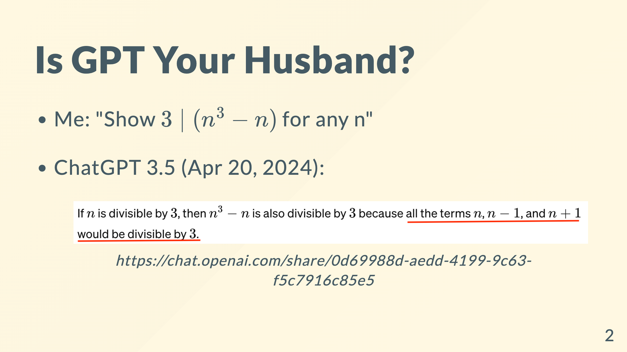

Slide 3
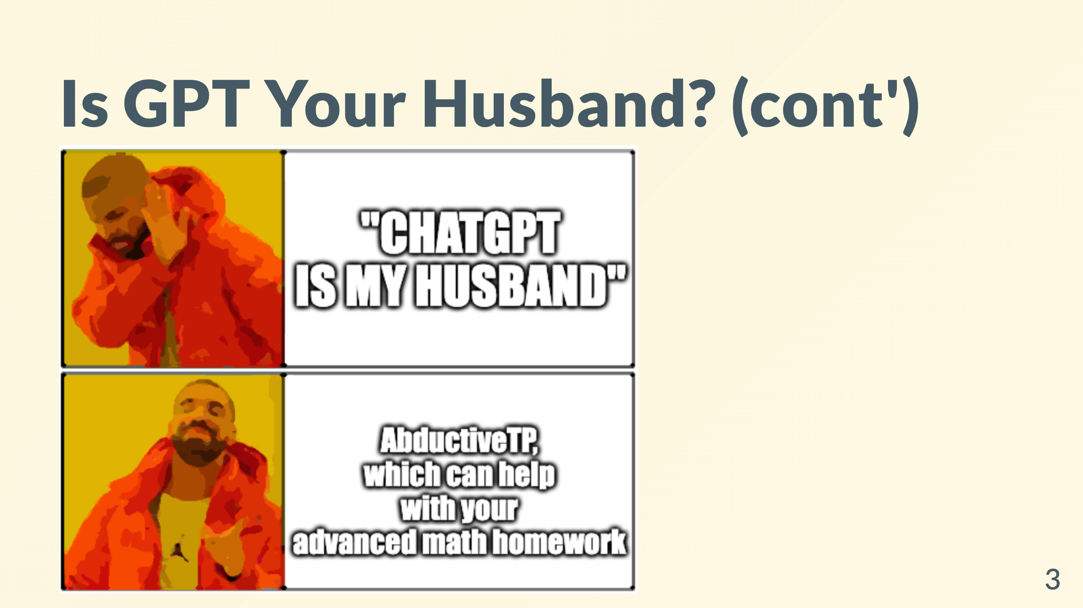

Slide 4
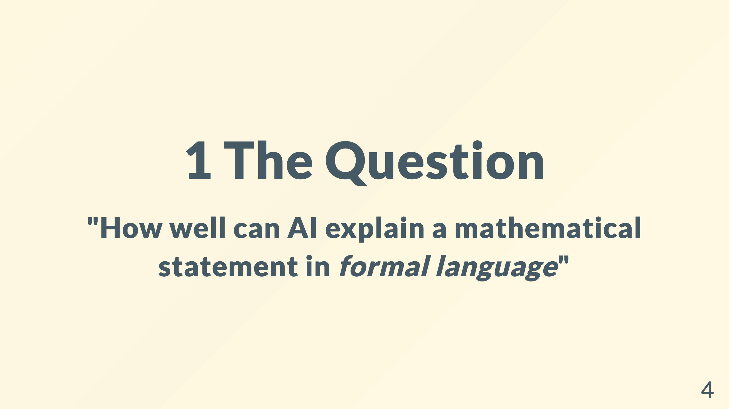
Notes:
(e.g. a homework problem that ask for a proof) * <span class="morph" style="--morph-name:m1;">Why explain</span> * Why math

Slide 5
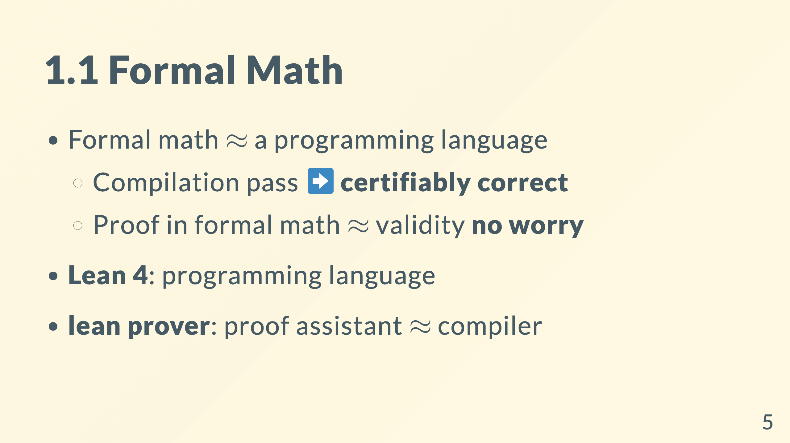
Notes:
"checks that these proofs are correct down to their logical foundation" - logical foundation: dependent type theory (DTT)

Slide 6
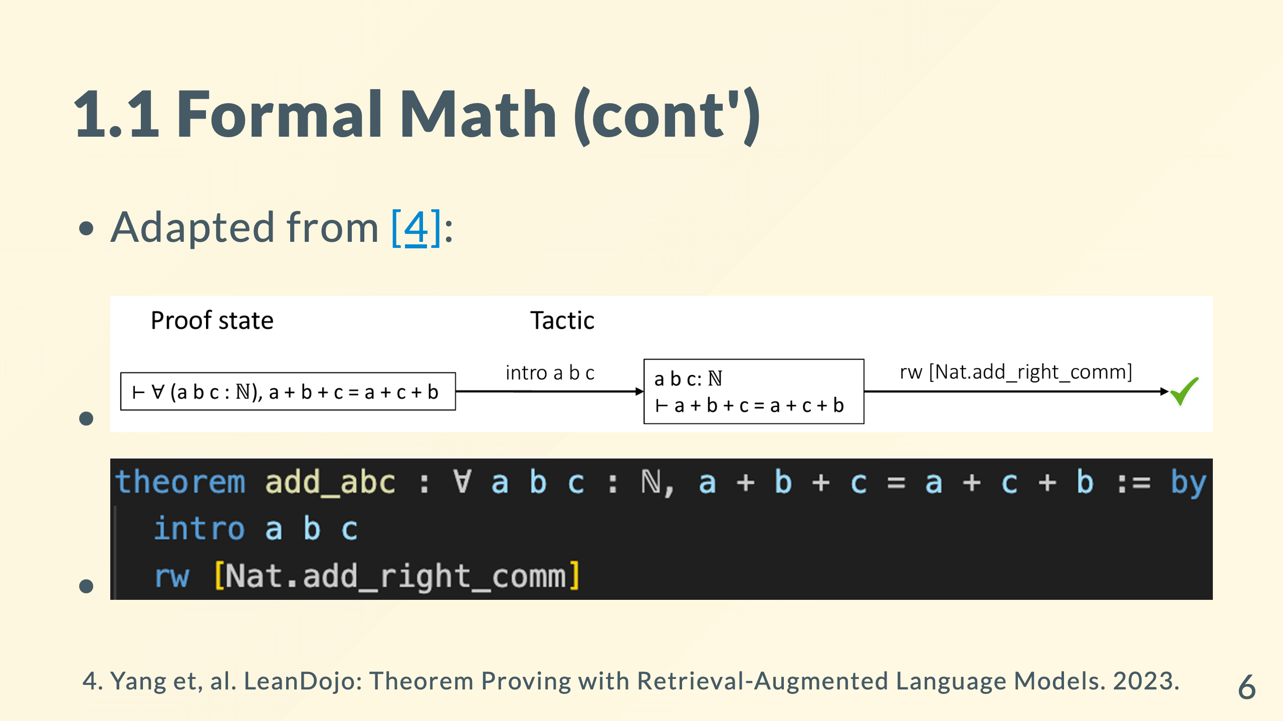

Slide 7
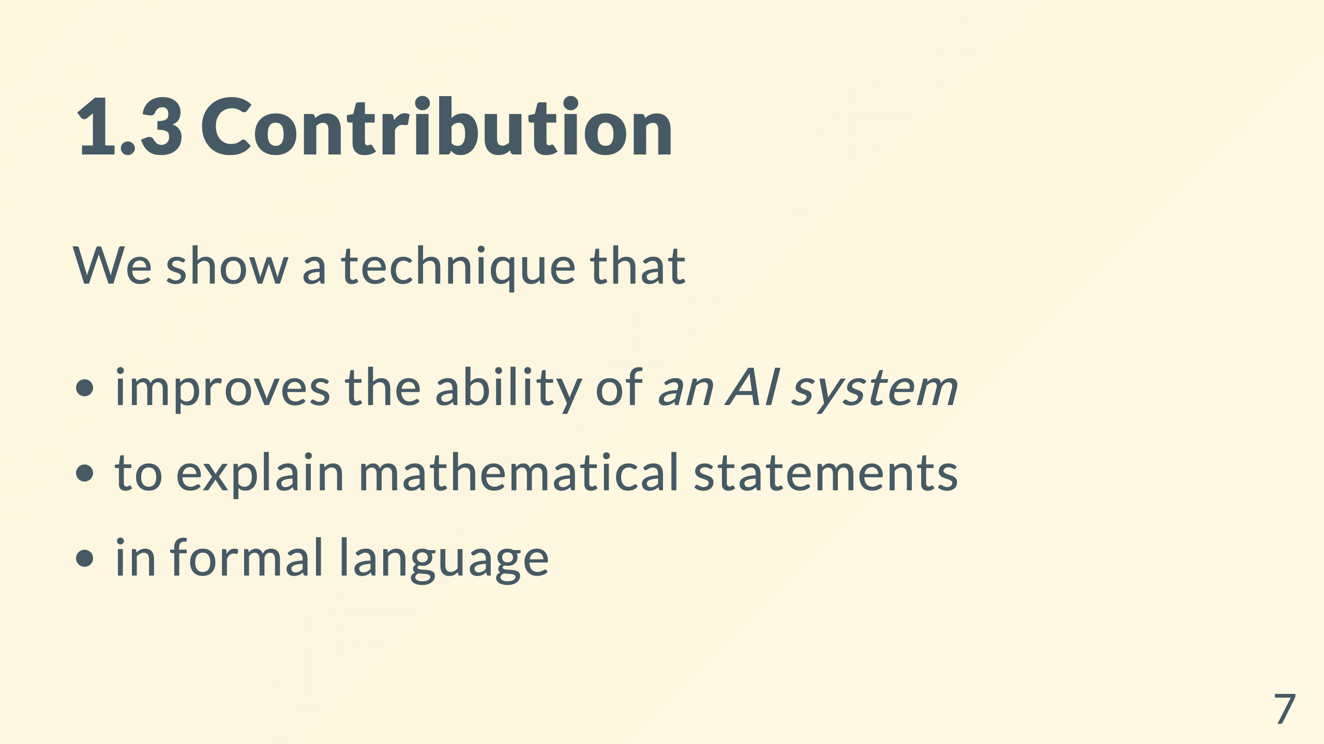
Notes:
pause here to wake people up

Slide 8
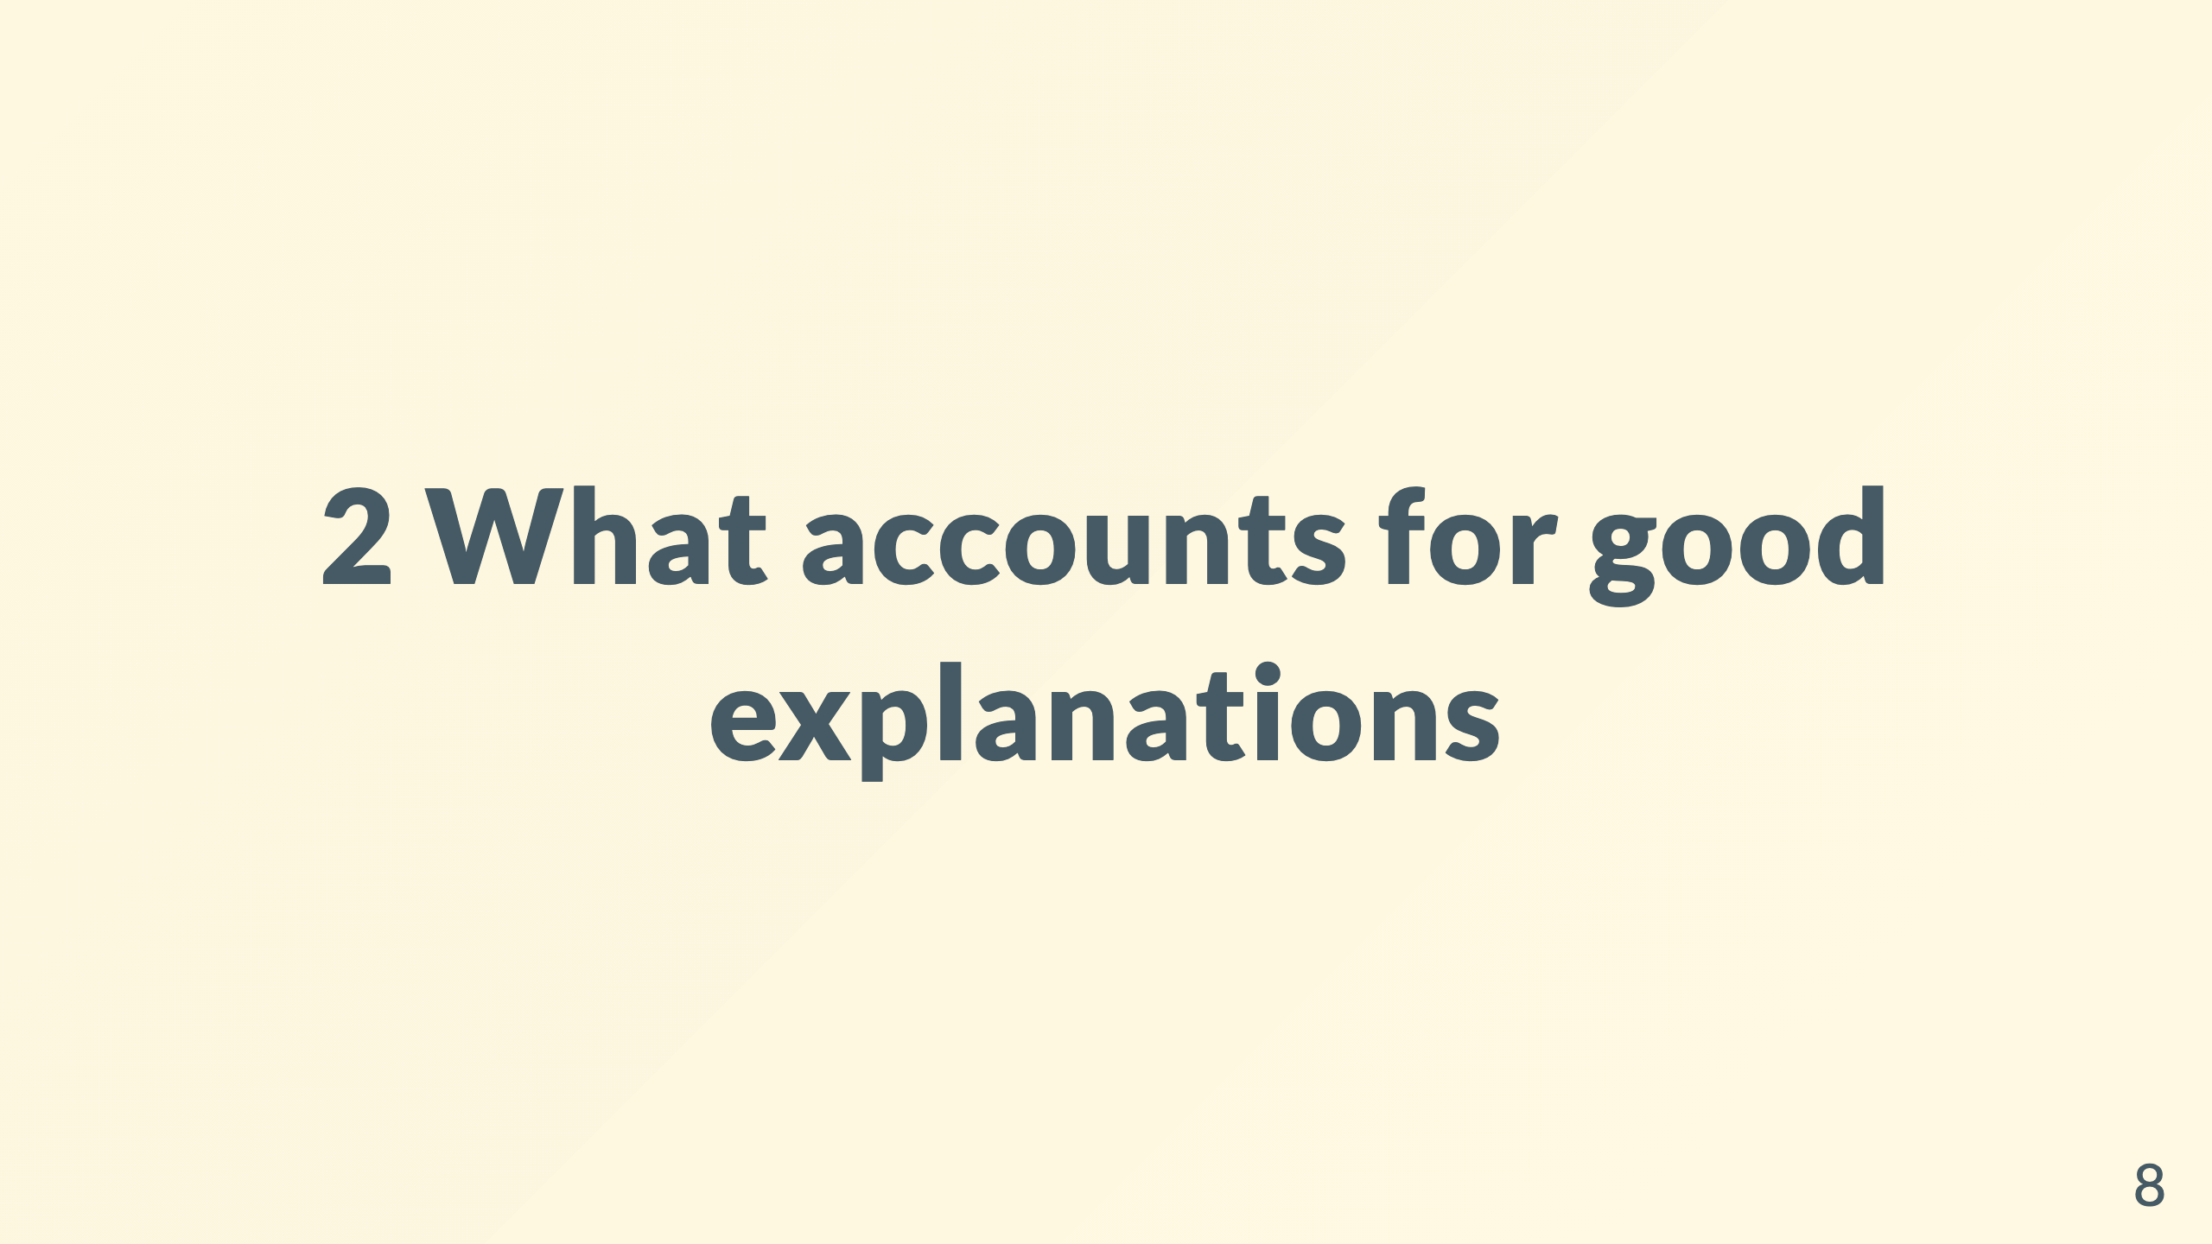
Notes:
code -> parsing tree -> show definition is easy Click a concept -> see definition

Slide 9
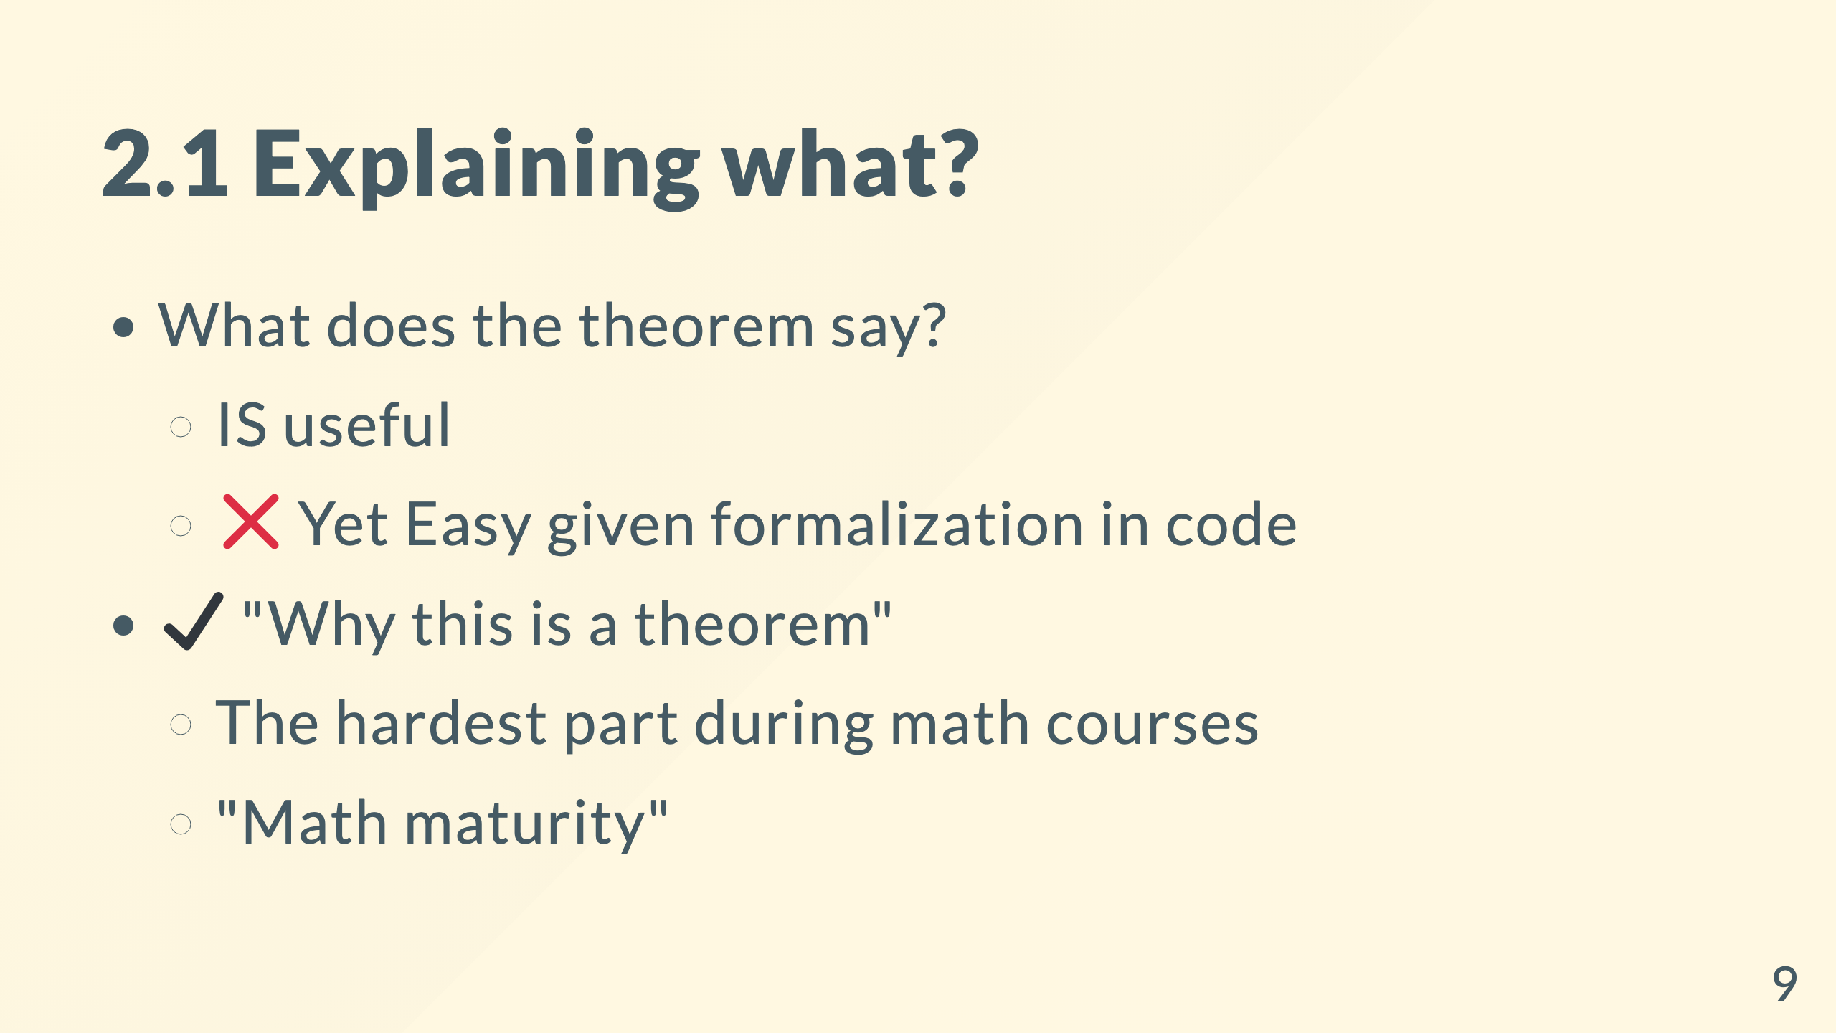

Slide 10
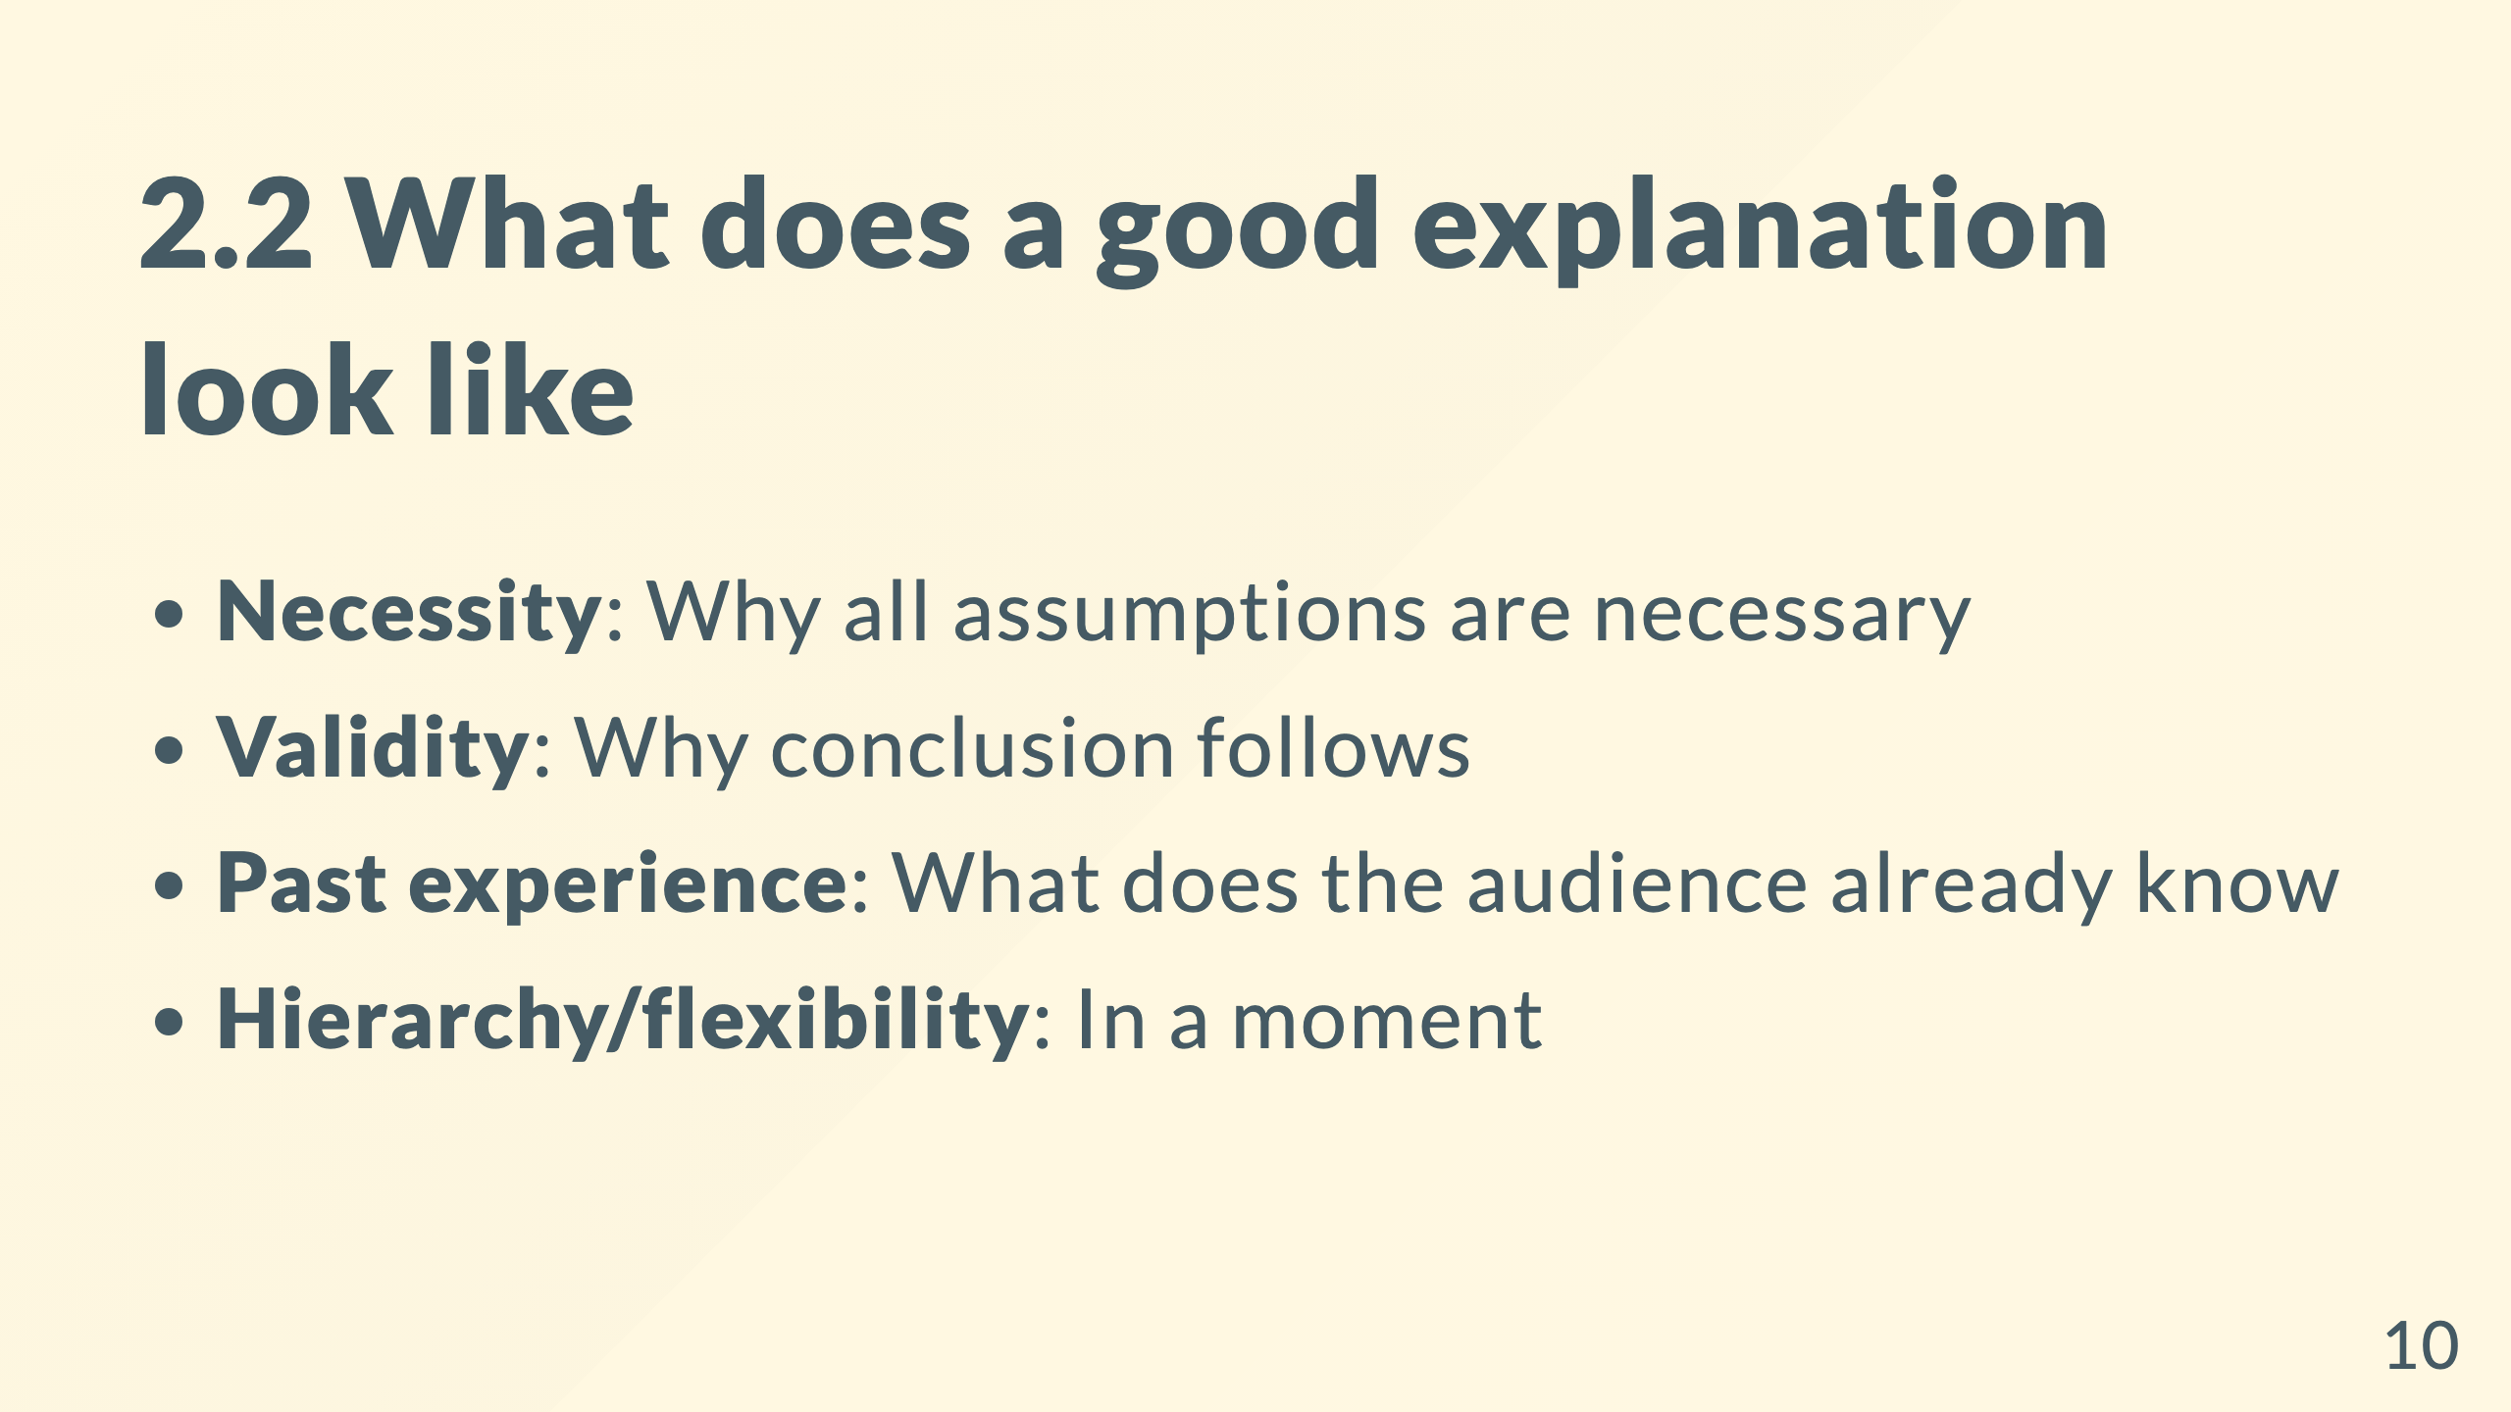
Notes:
- A valid proof showing the necessity of the assumptions (E.g. by counter-examples). - A valid proof showing the sufficiency of the assumptions. - Connects to knowledge and beliefs the performer already has. - **Hierarchy/flexibility**: A proof that is structured and to the point in every local step.

Slide 11
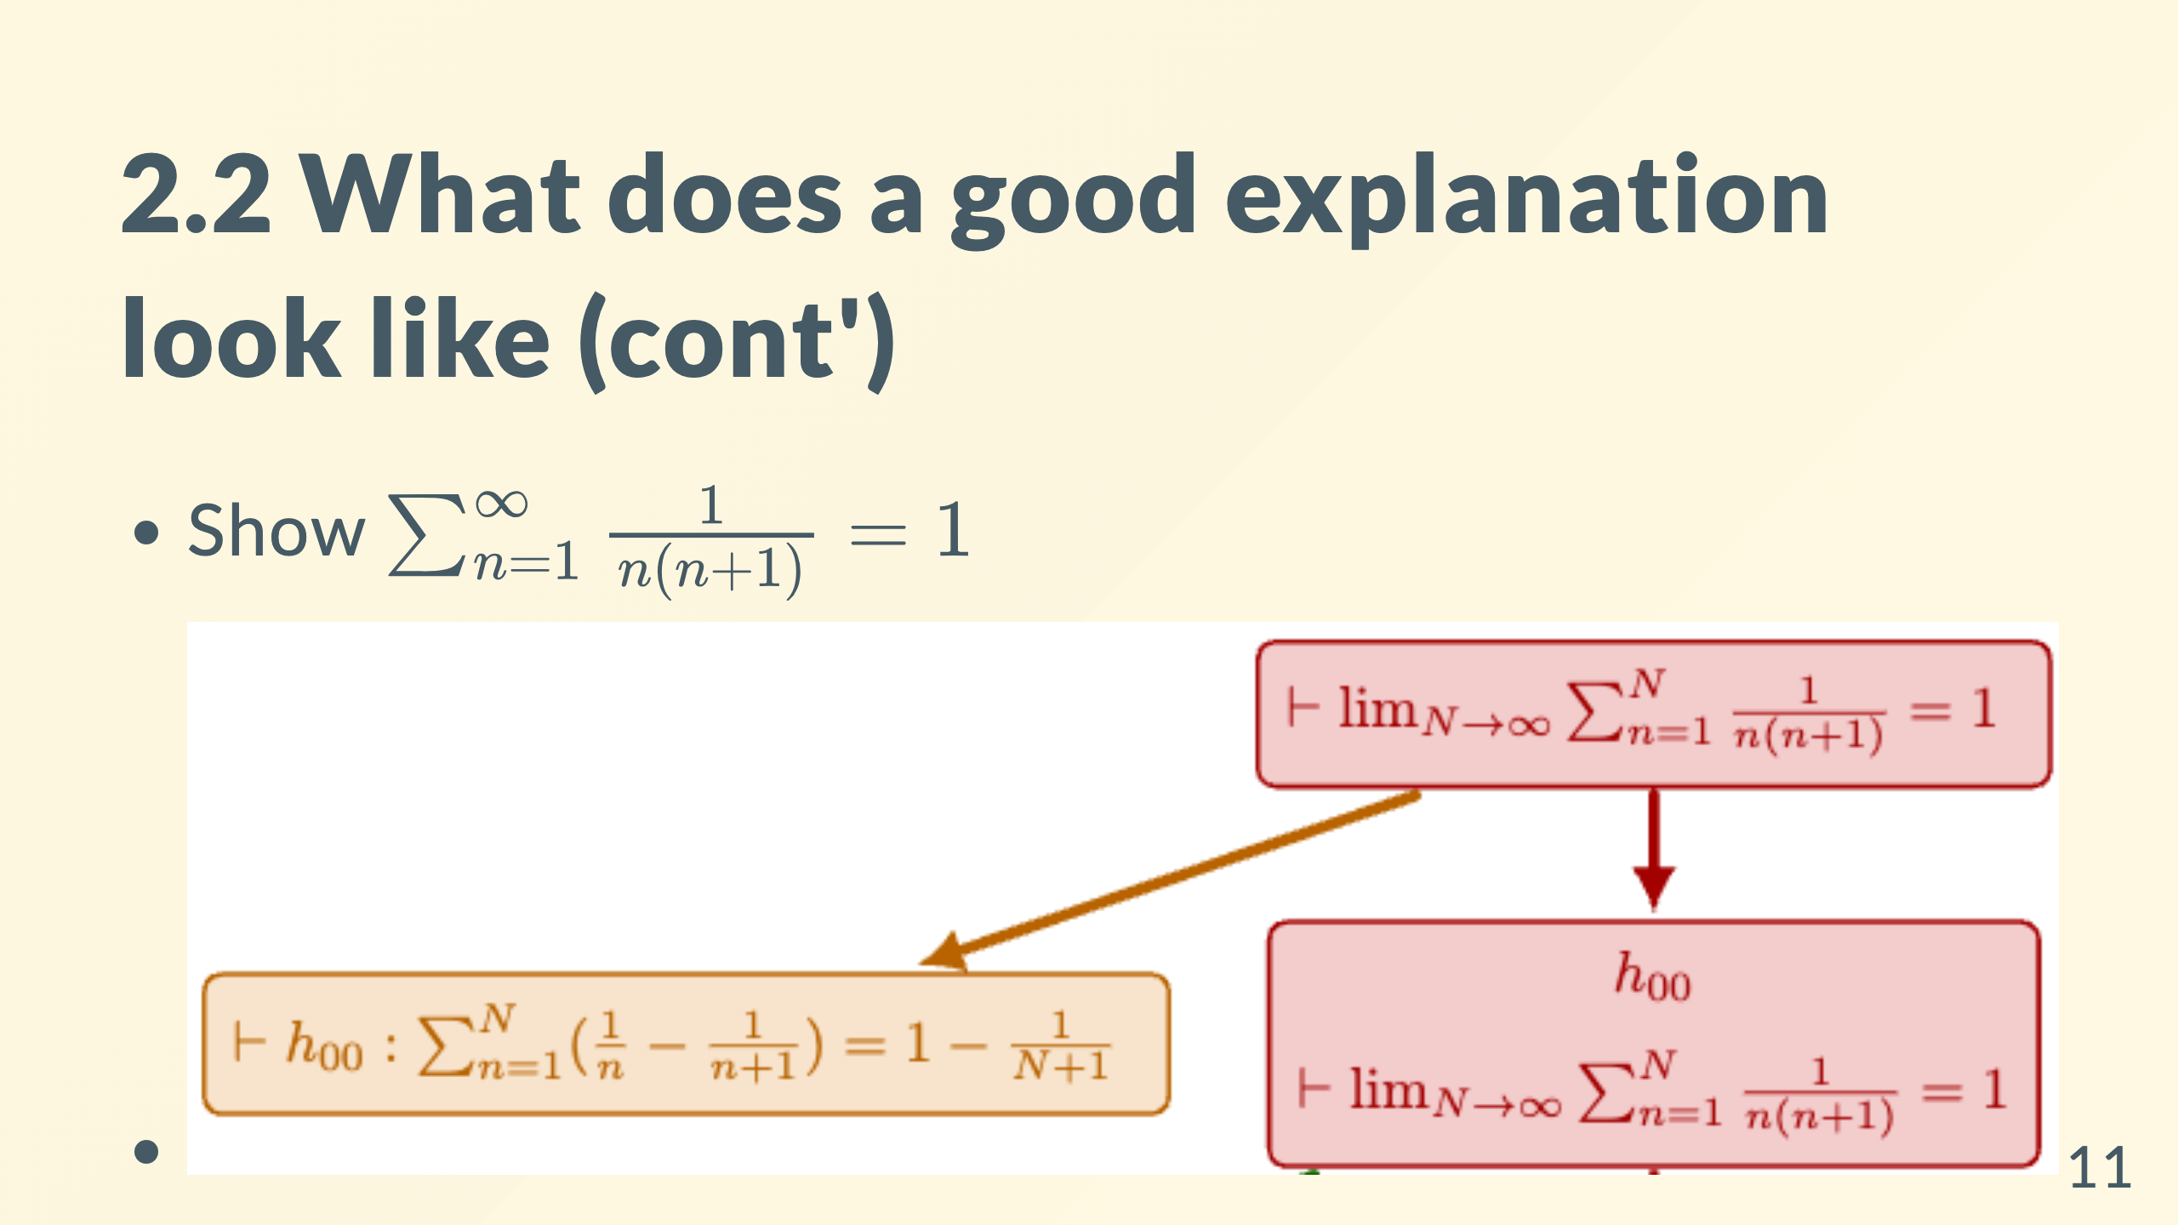
Notes:
Is the yellow box an explanation? Yes, a very brief one. So-called “selected” explanation. I call it hierarchical explanation: take whatever level of detail you want. The most complete one: a certifiably valid proof.

Slide 12
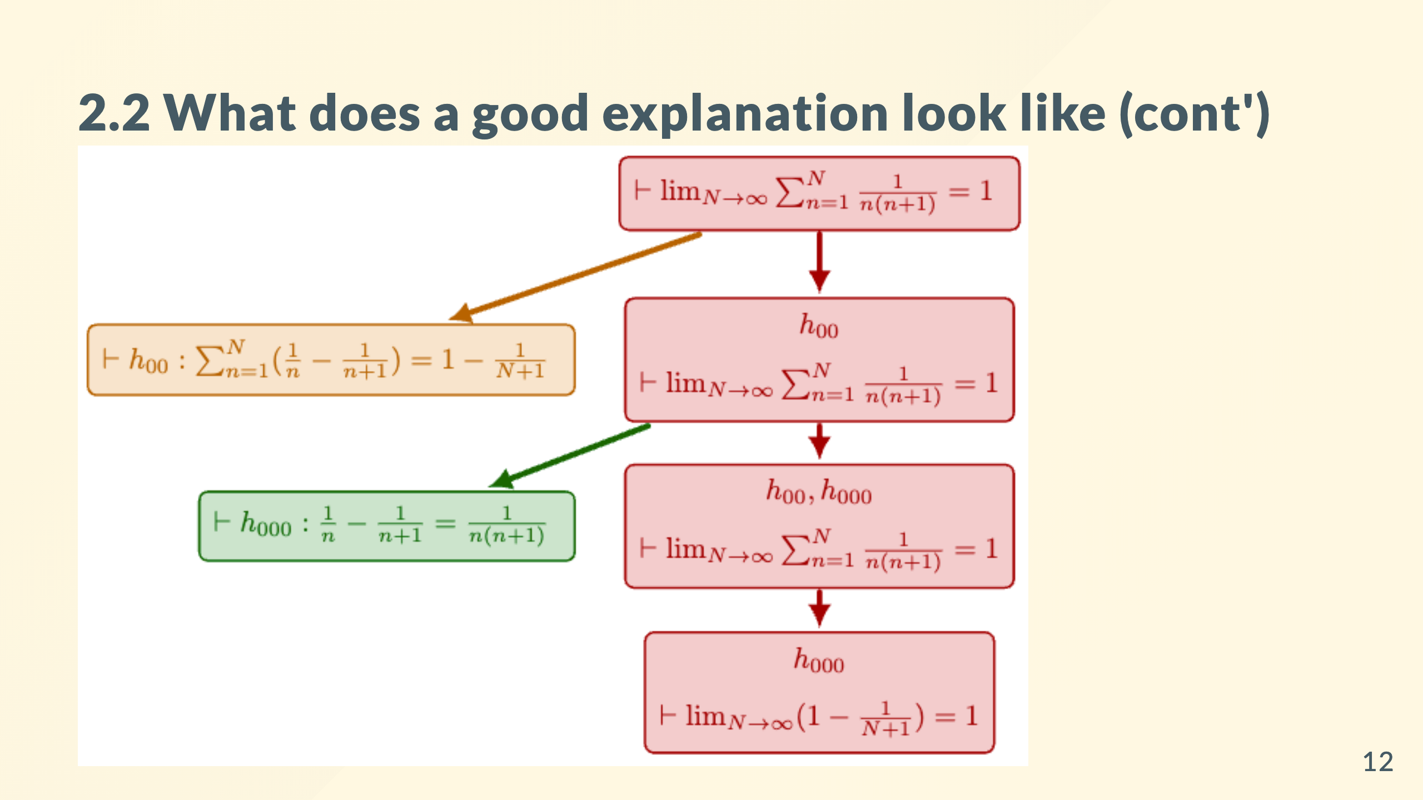

Slide 13
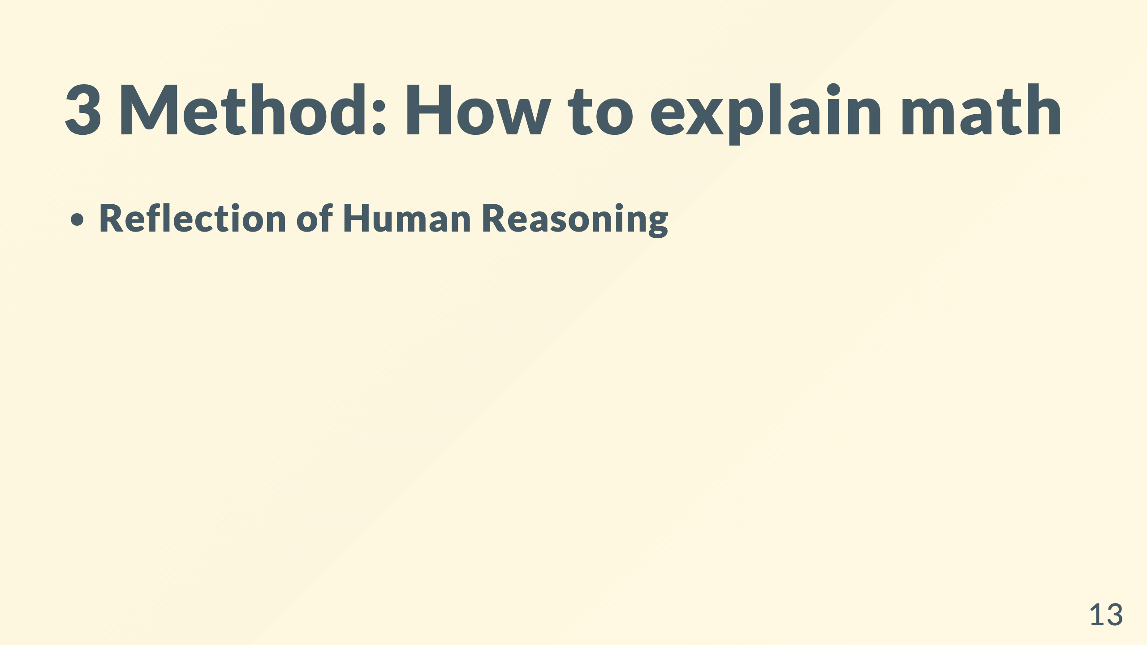

Slide 14
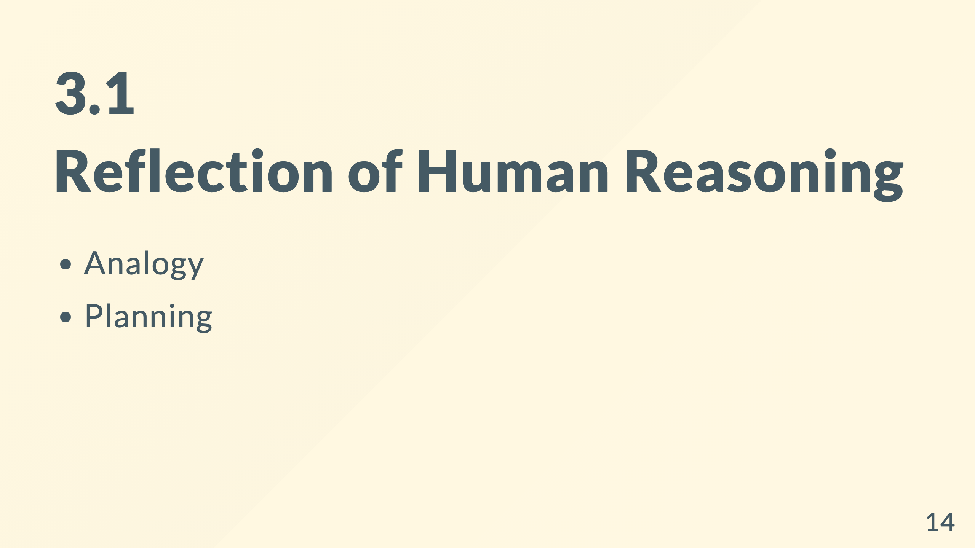

Slide 15
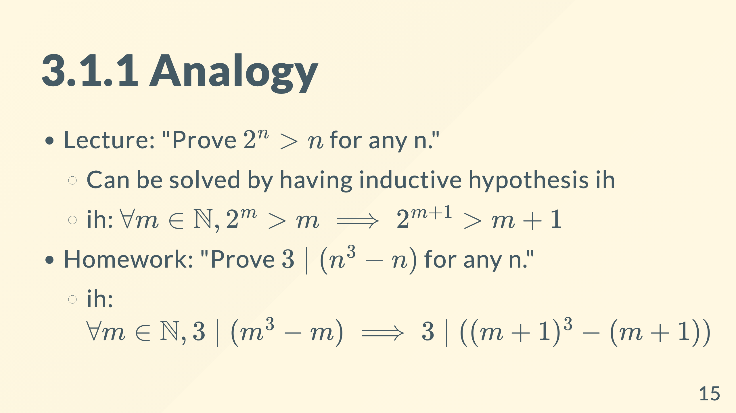
Notes:
Suppose Never learned "proof by induction" Now you learned a technique without necessarily knowing the name. * Most of the techniques are nameless. * Yet you remember them to succeed in the exam.

Slide 16
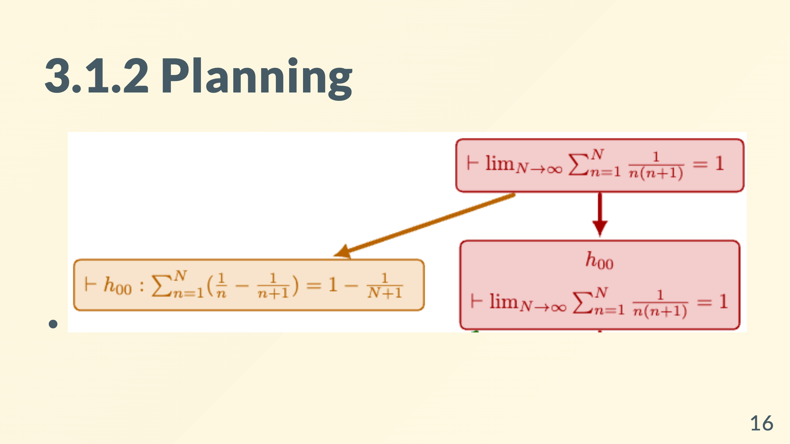
Notes:
If I try to explain A, I decompose it into B and C. Since B and C are independent, I can explain them separately. Suppose B is hard, I decompose it into D and E...

Slide 17
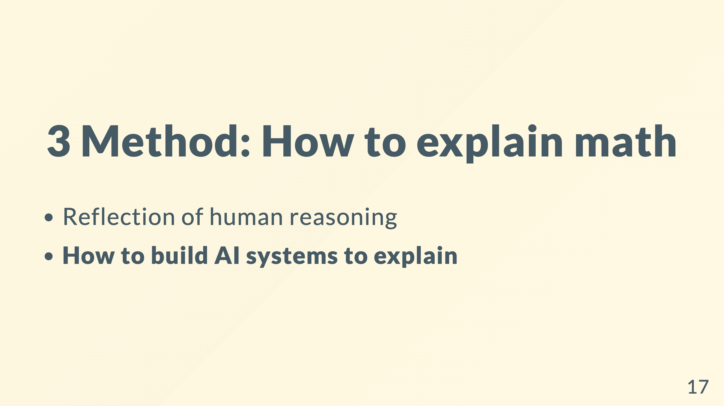
Notes:
ah, finally. are you ready?

Slide 18
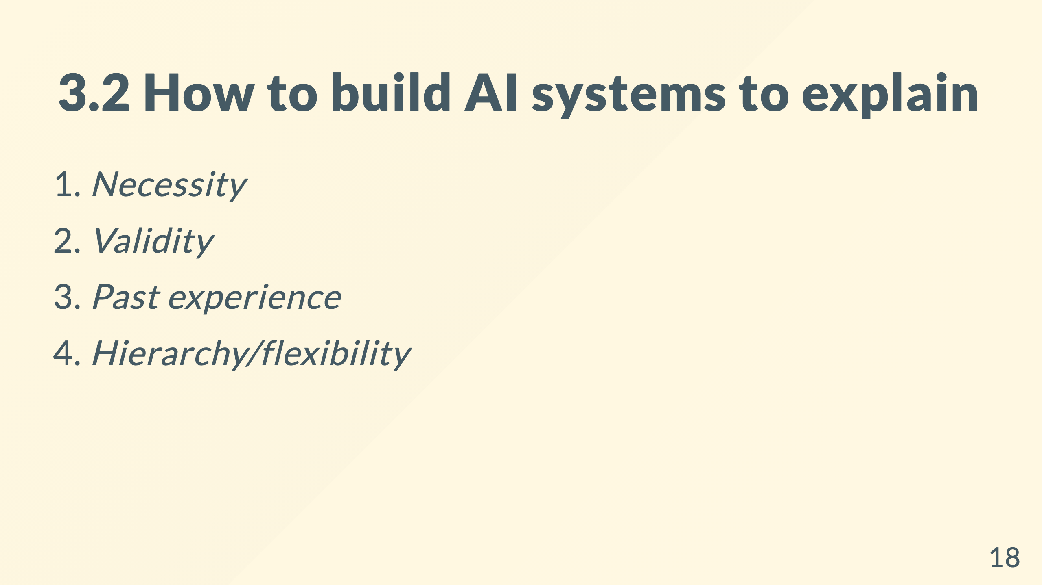

Slide 19
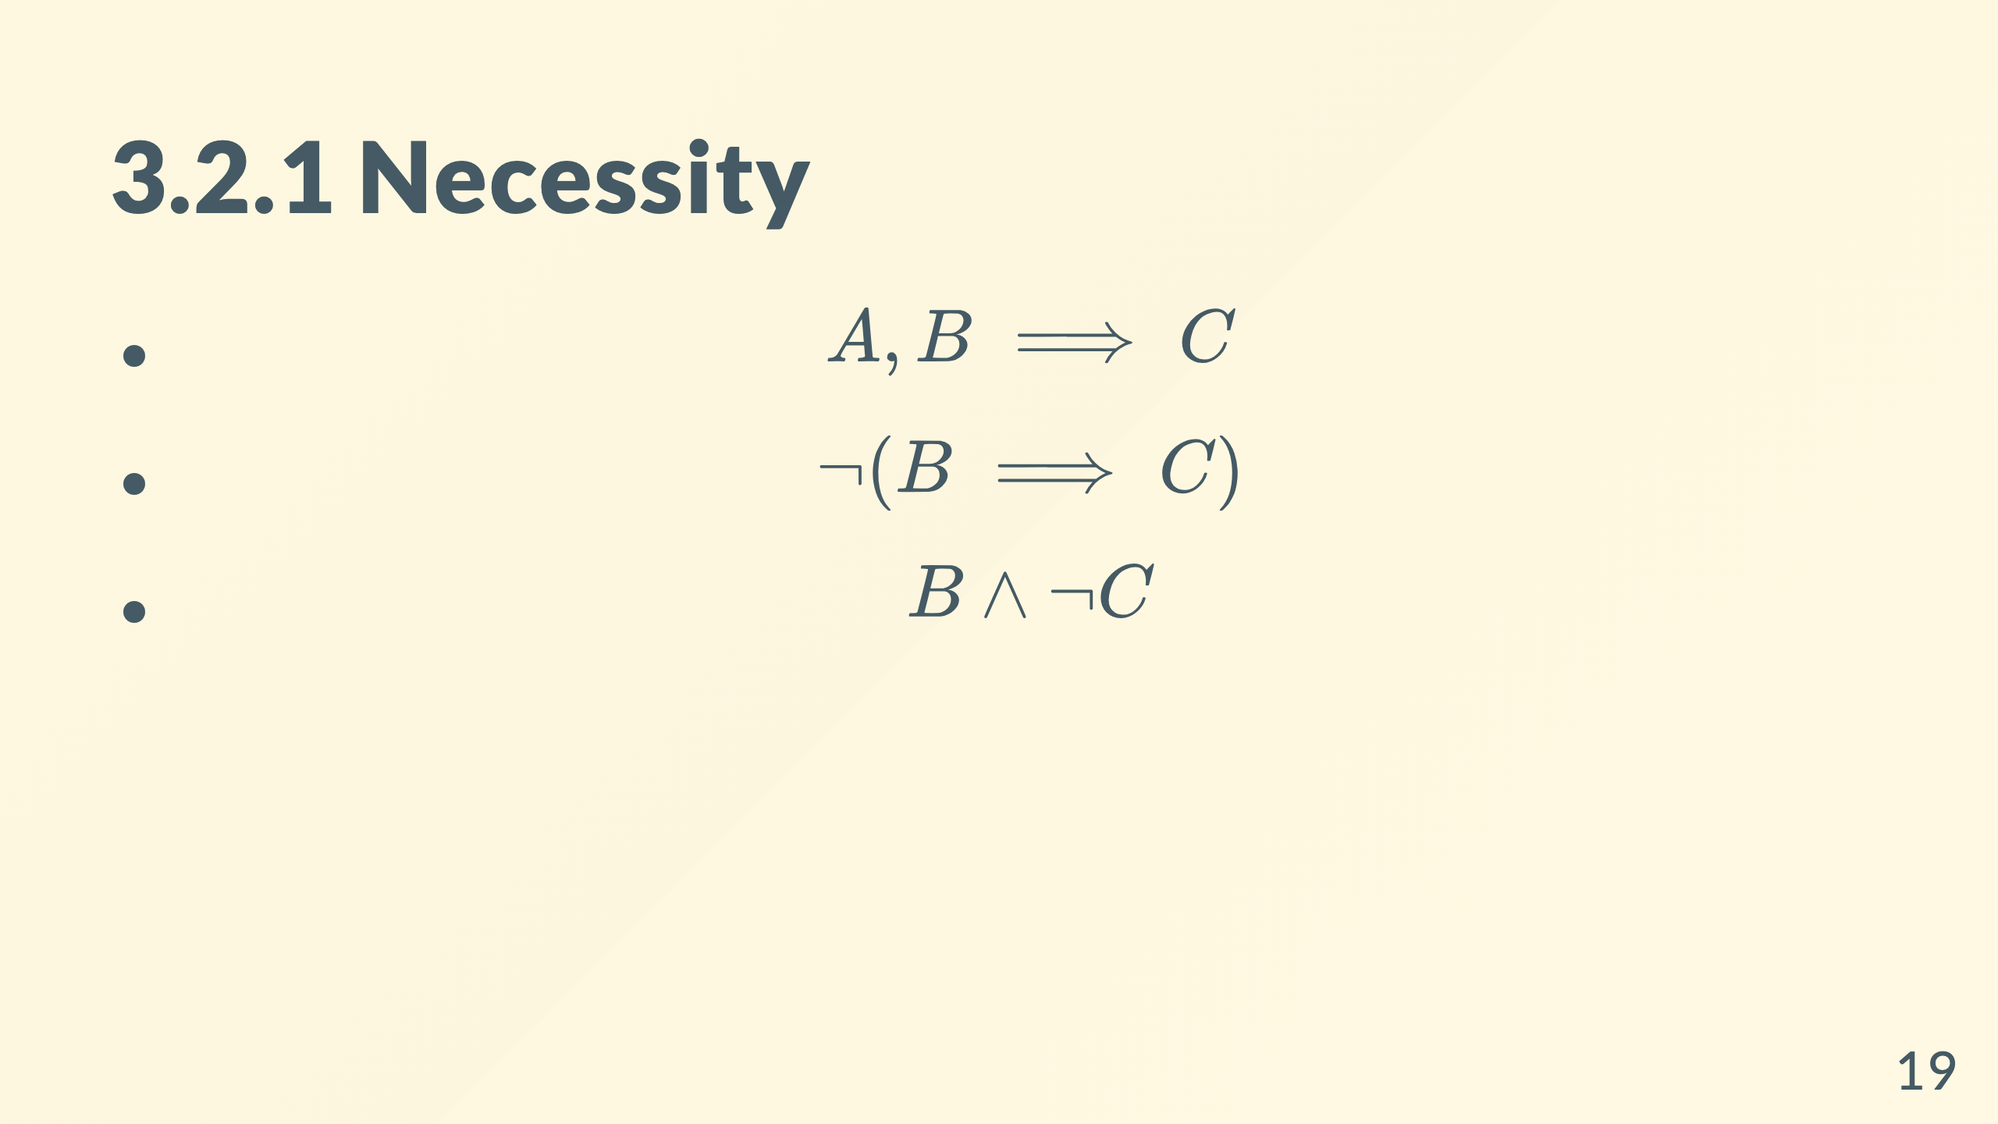
Notes:
An example of a proof goal/state <figure> <img src="../figs/proof_state.png" alt="" width="100%"> <figcaption>Two need justification: 5th and 7th</figcaption> </figure>

Slide 20
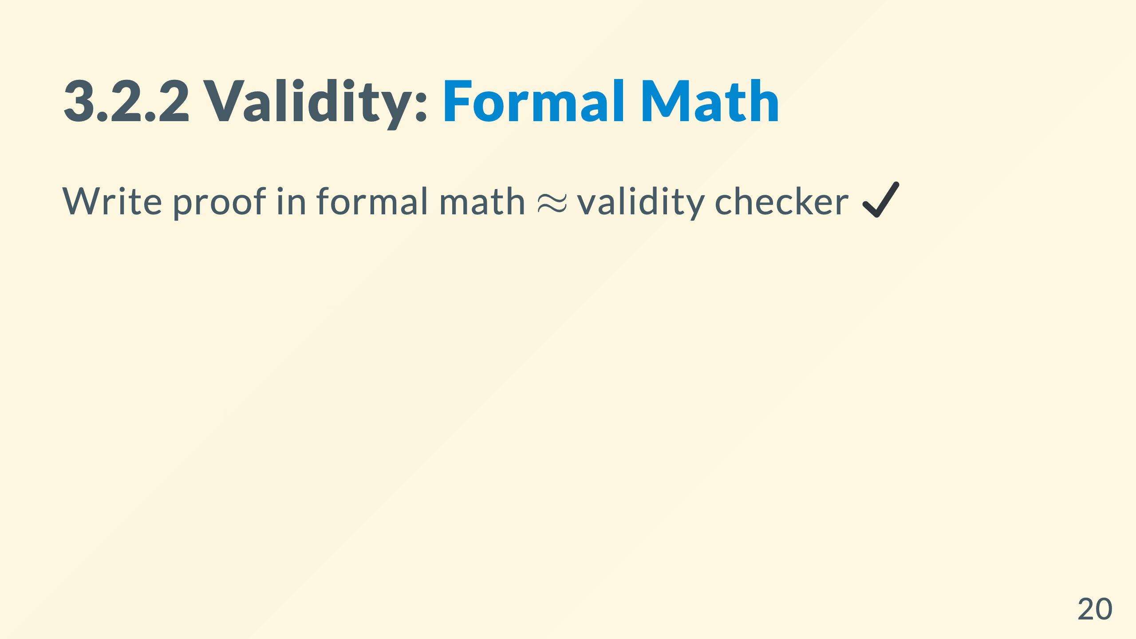
Notes:
A more complicated example: <figure> <img src="../figs/ex2_src.png" alt="" width="100%"> <figcaption>A hierarchical proof</figcaption> </figure> <figure> <img src="https://leandojo.org/images/LeanDojo.jpg" alt="" width="100%"> <figcaption></figcaption> </figure>

Slide 21
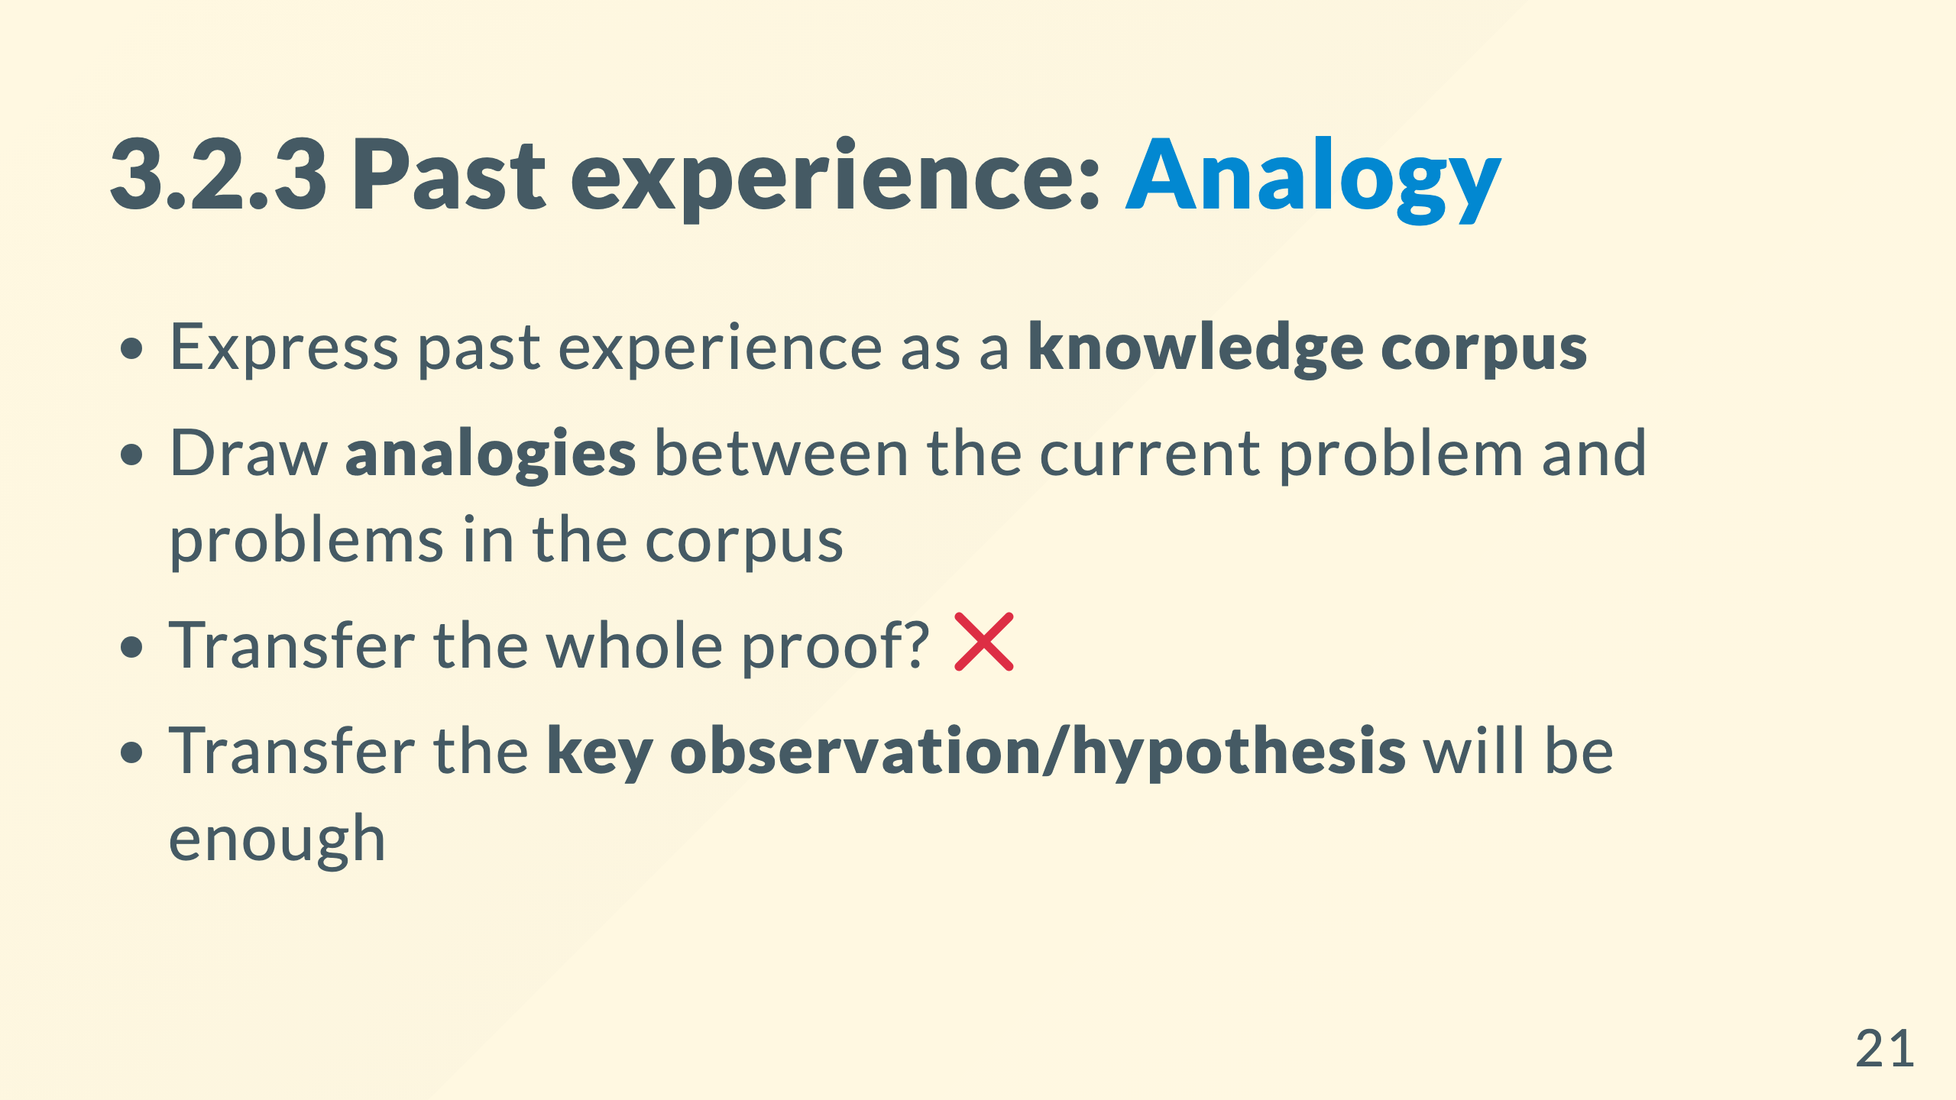
Notes:
Q: Analogy between what? * A: Between the local action that captures the essence

Slide 22
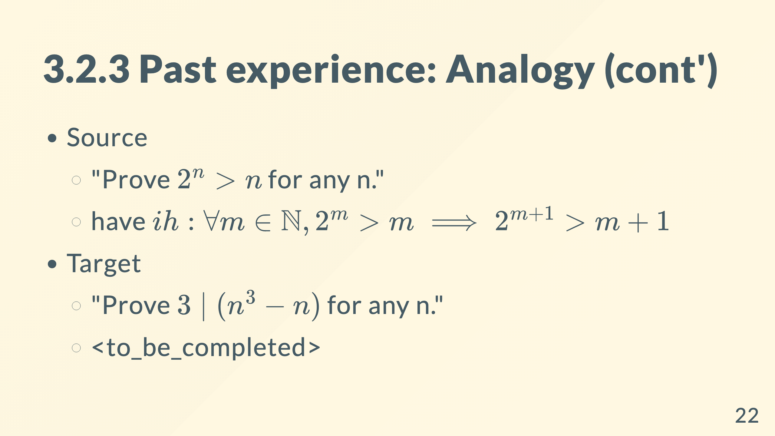
Notes:
the same example. just want to show you this is sufficient

Slide 23
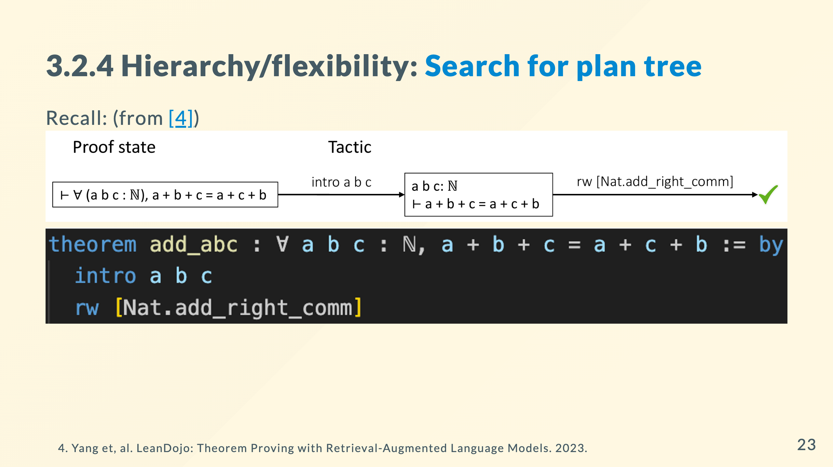

Slide 24
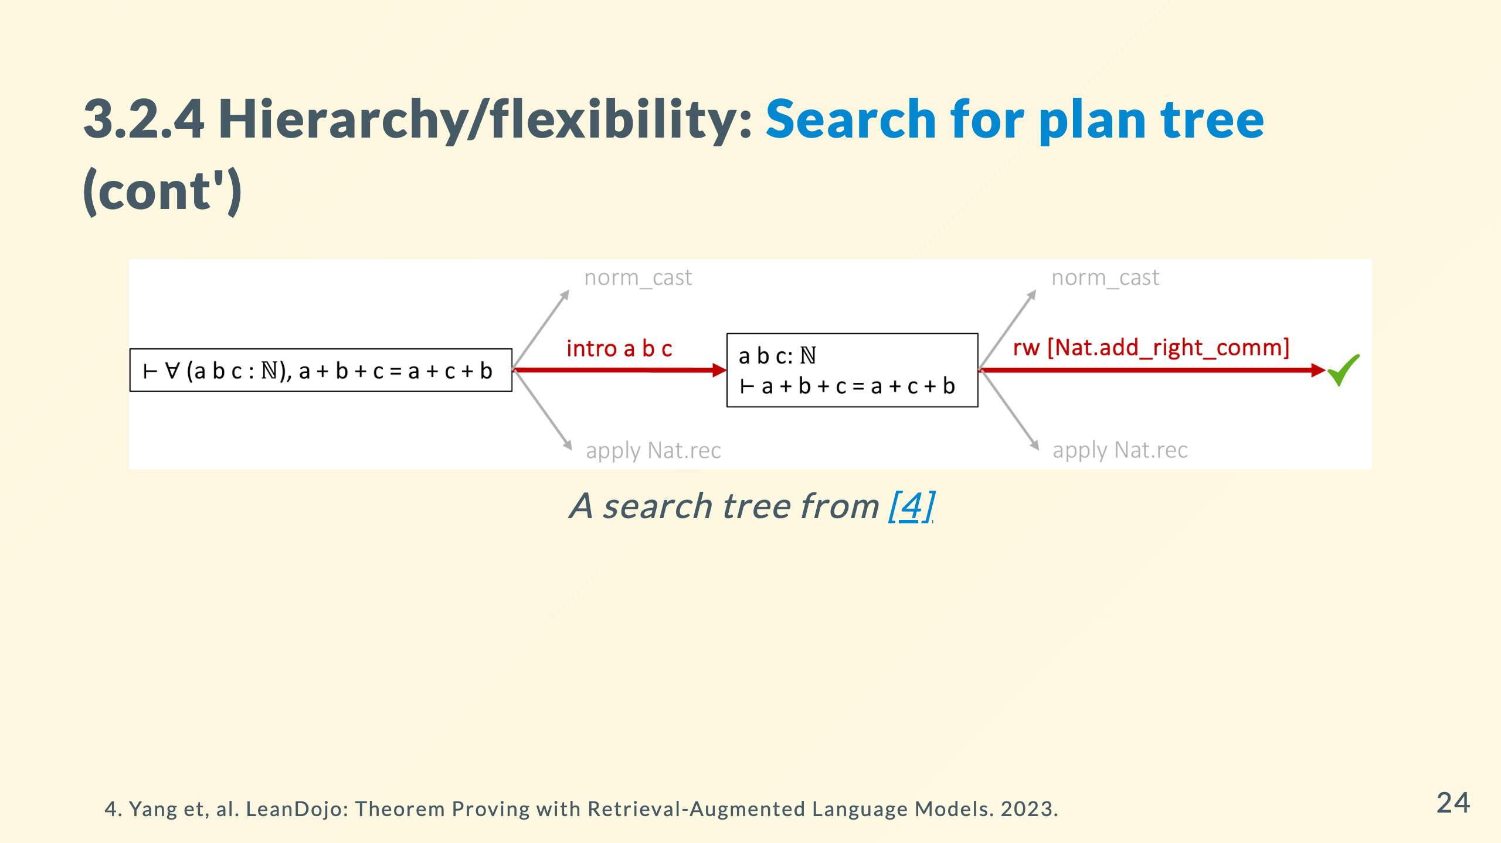

Slide 25
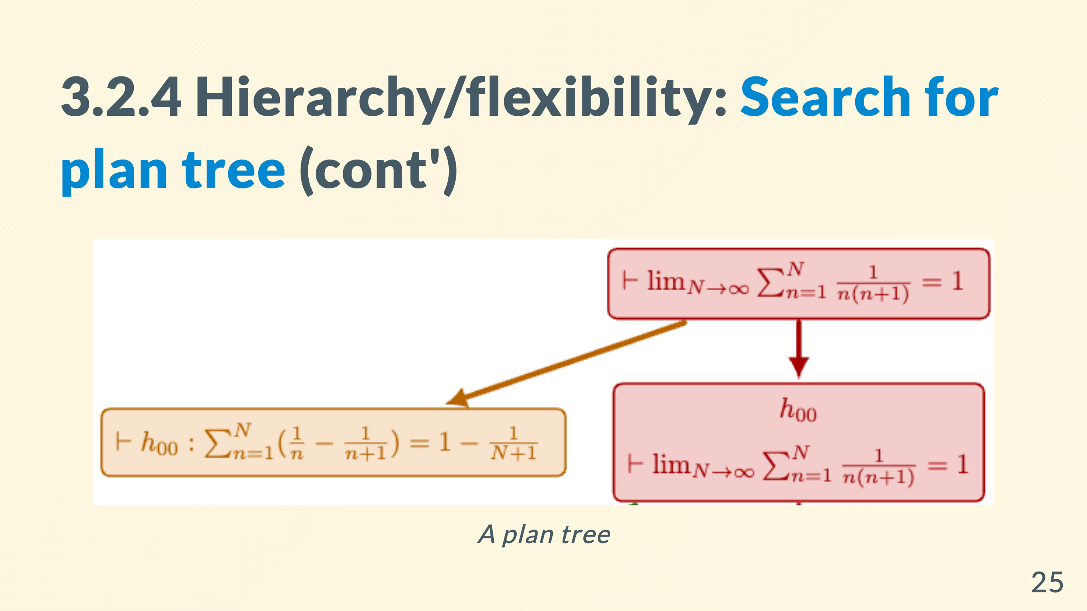
Notes:
such search for sequential steps is mindless. people make plan before dirty works

Slide 26
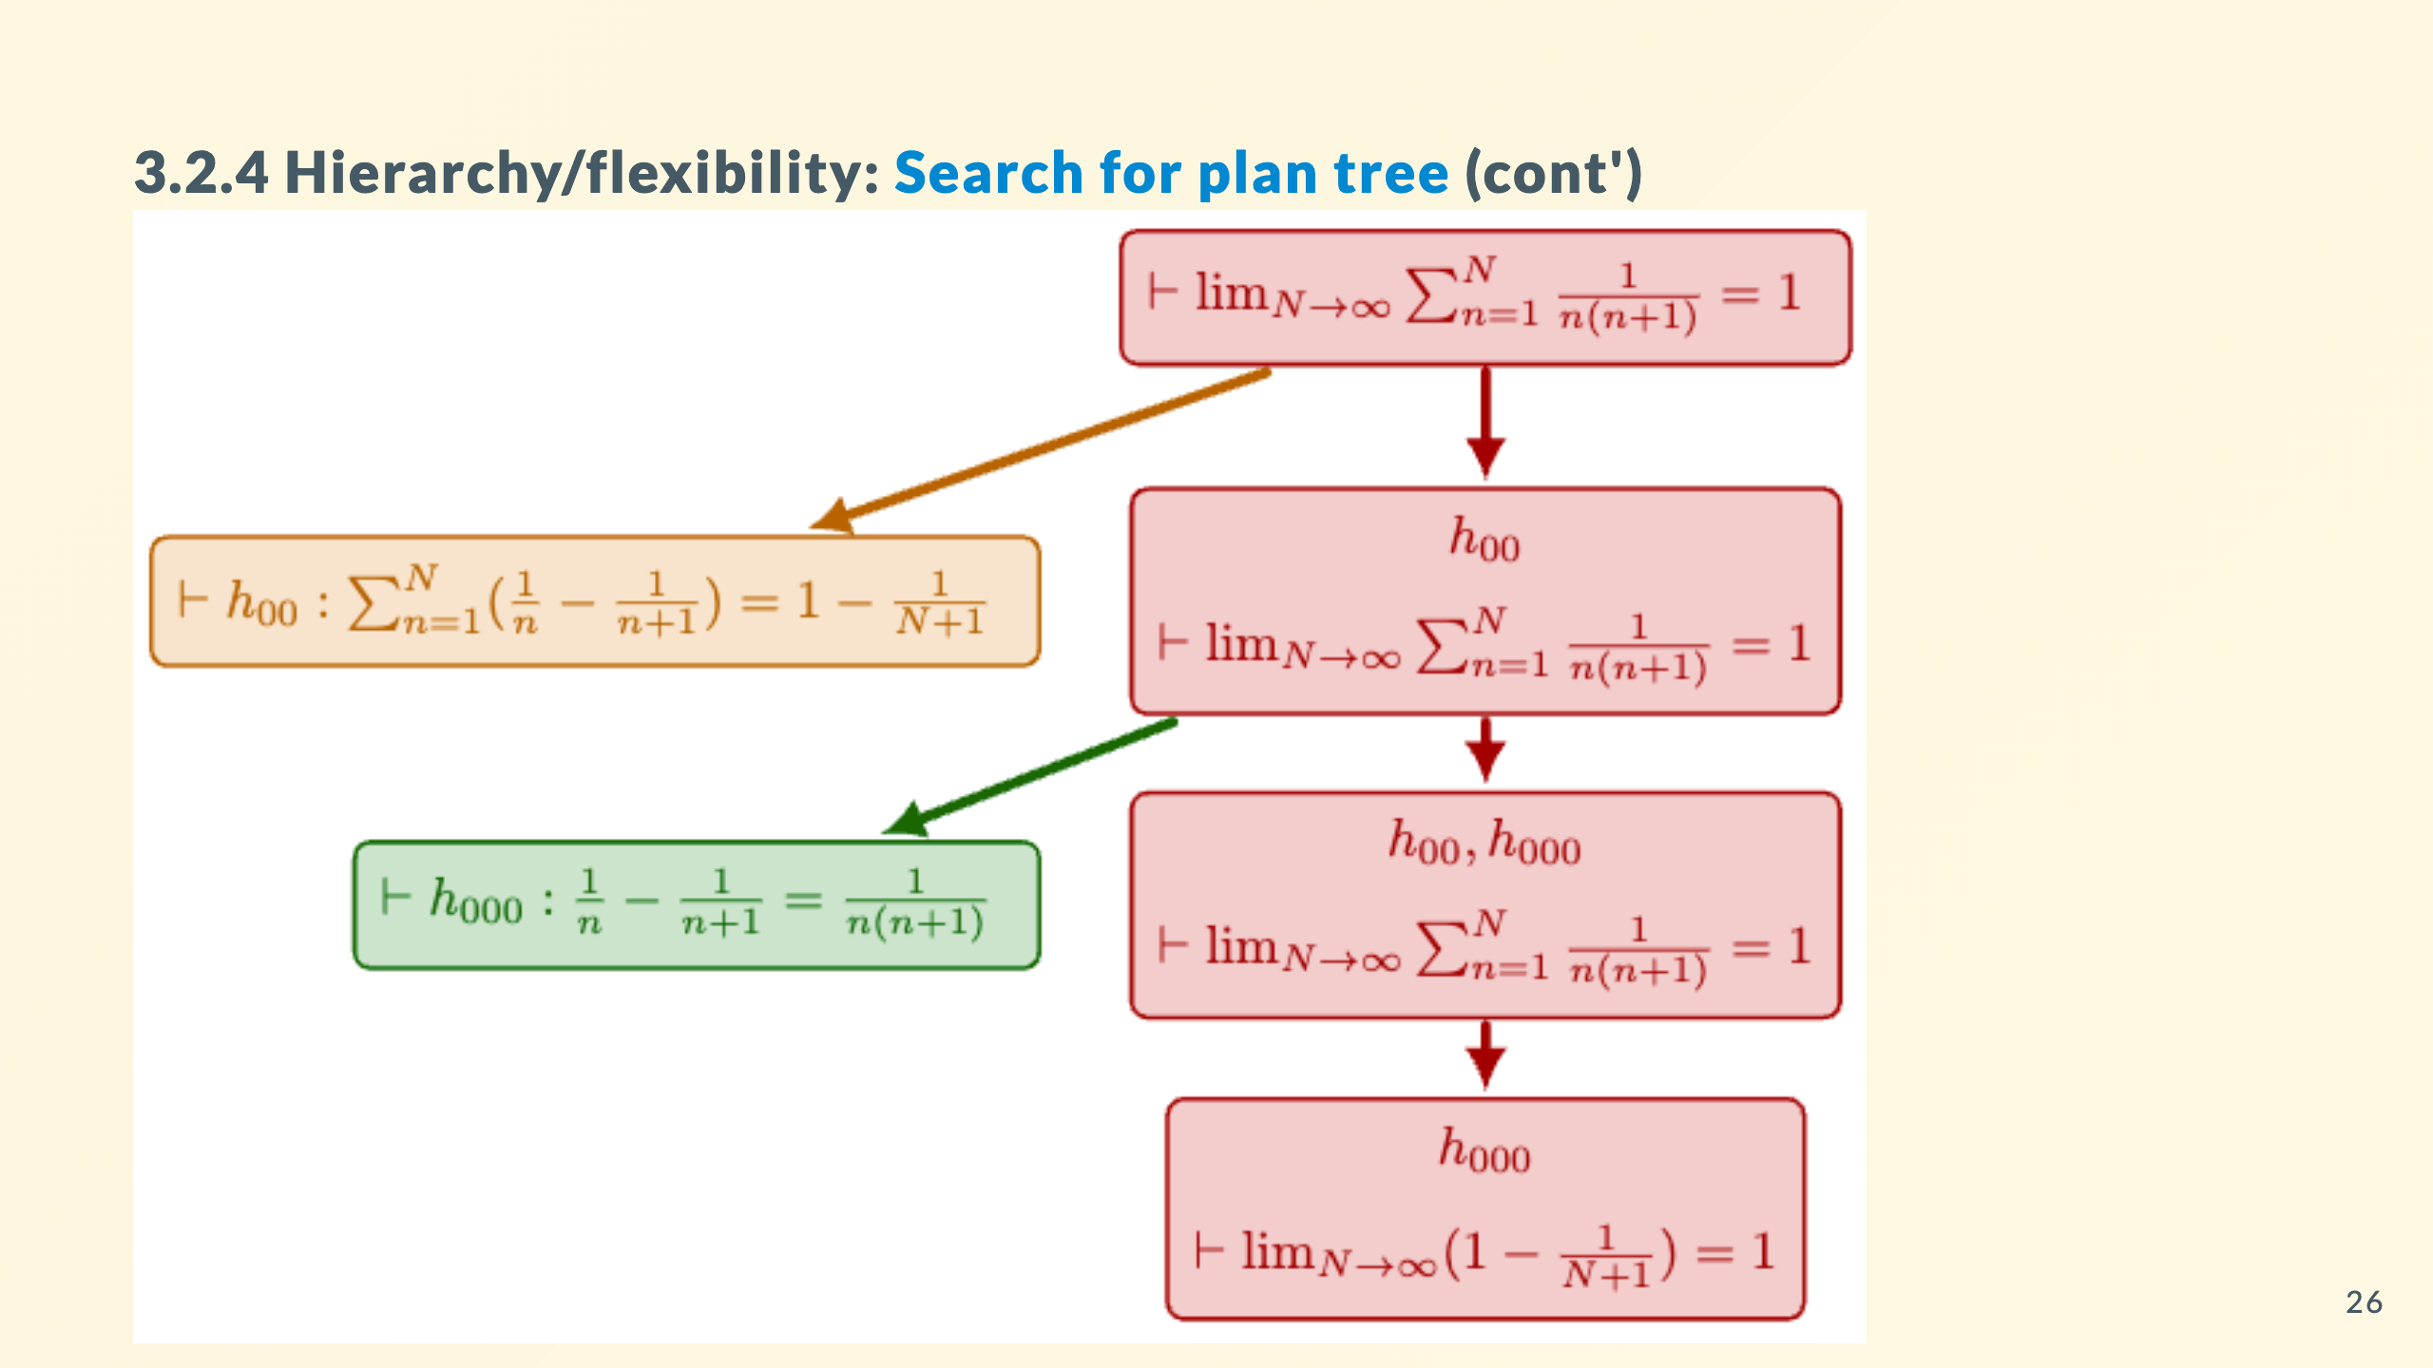
Notes:
yellow one and green one are independent. if I make plan by pointing out key points and decompose the problem, we get a high-quality plan tree.

Slide 27
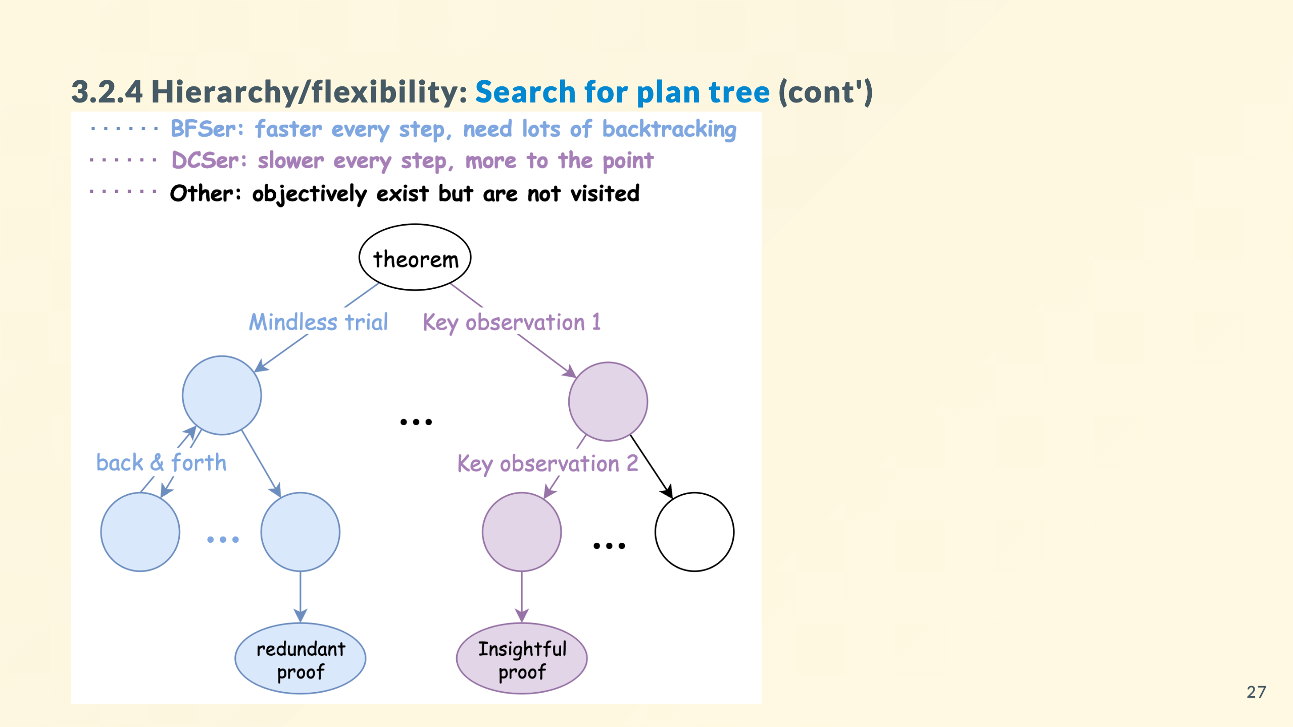
Notes:
BFSer is a baseline that searches sequentially. DCSer instead, tries to find key observations and decompose the problem.

Slide 28
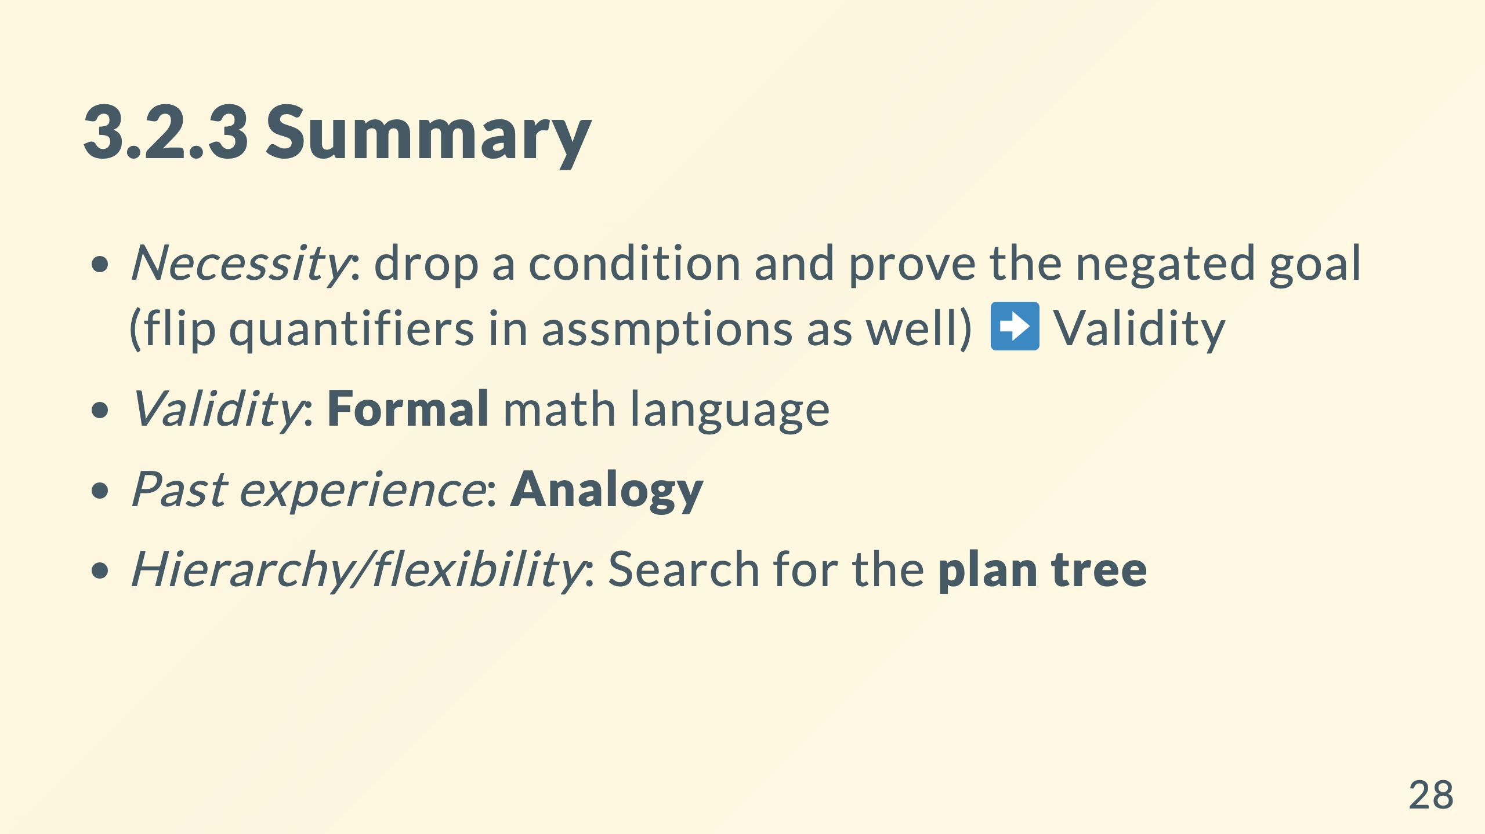

Slide 29
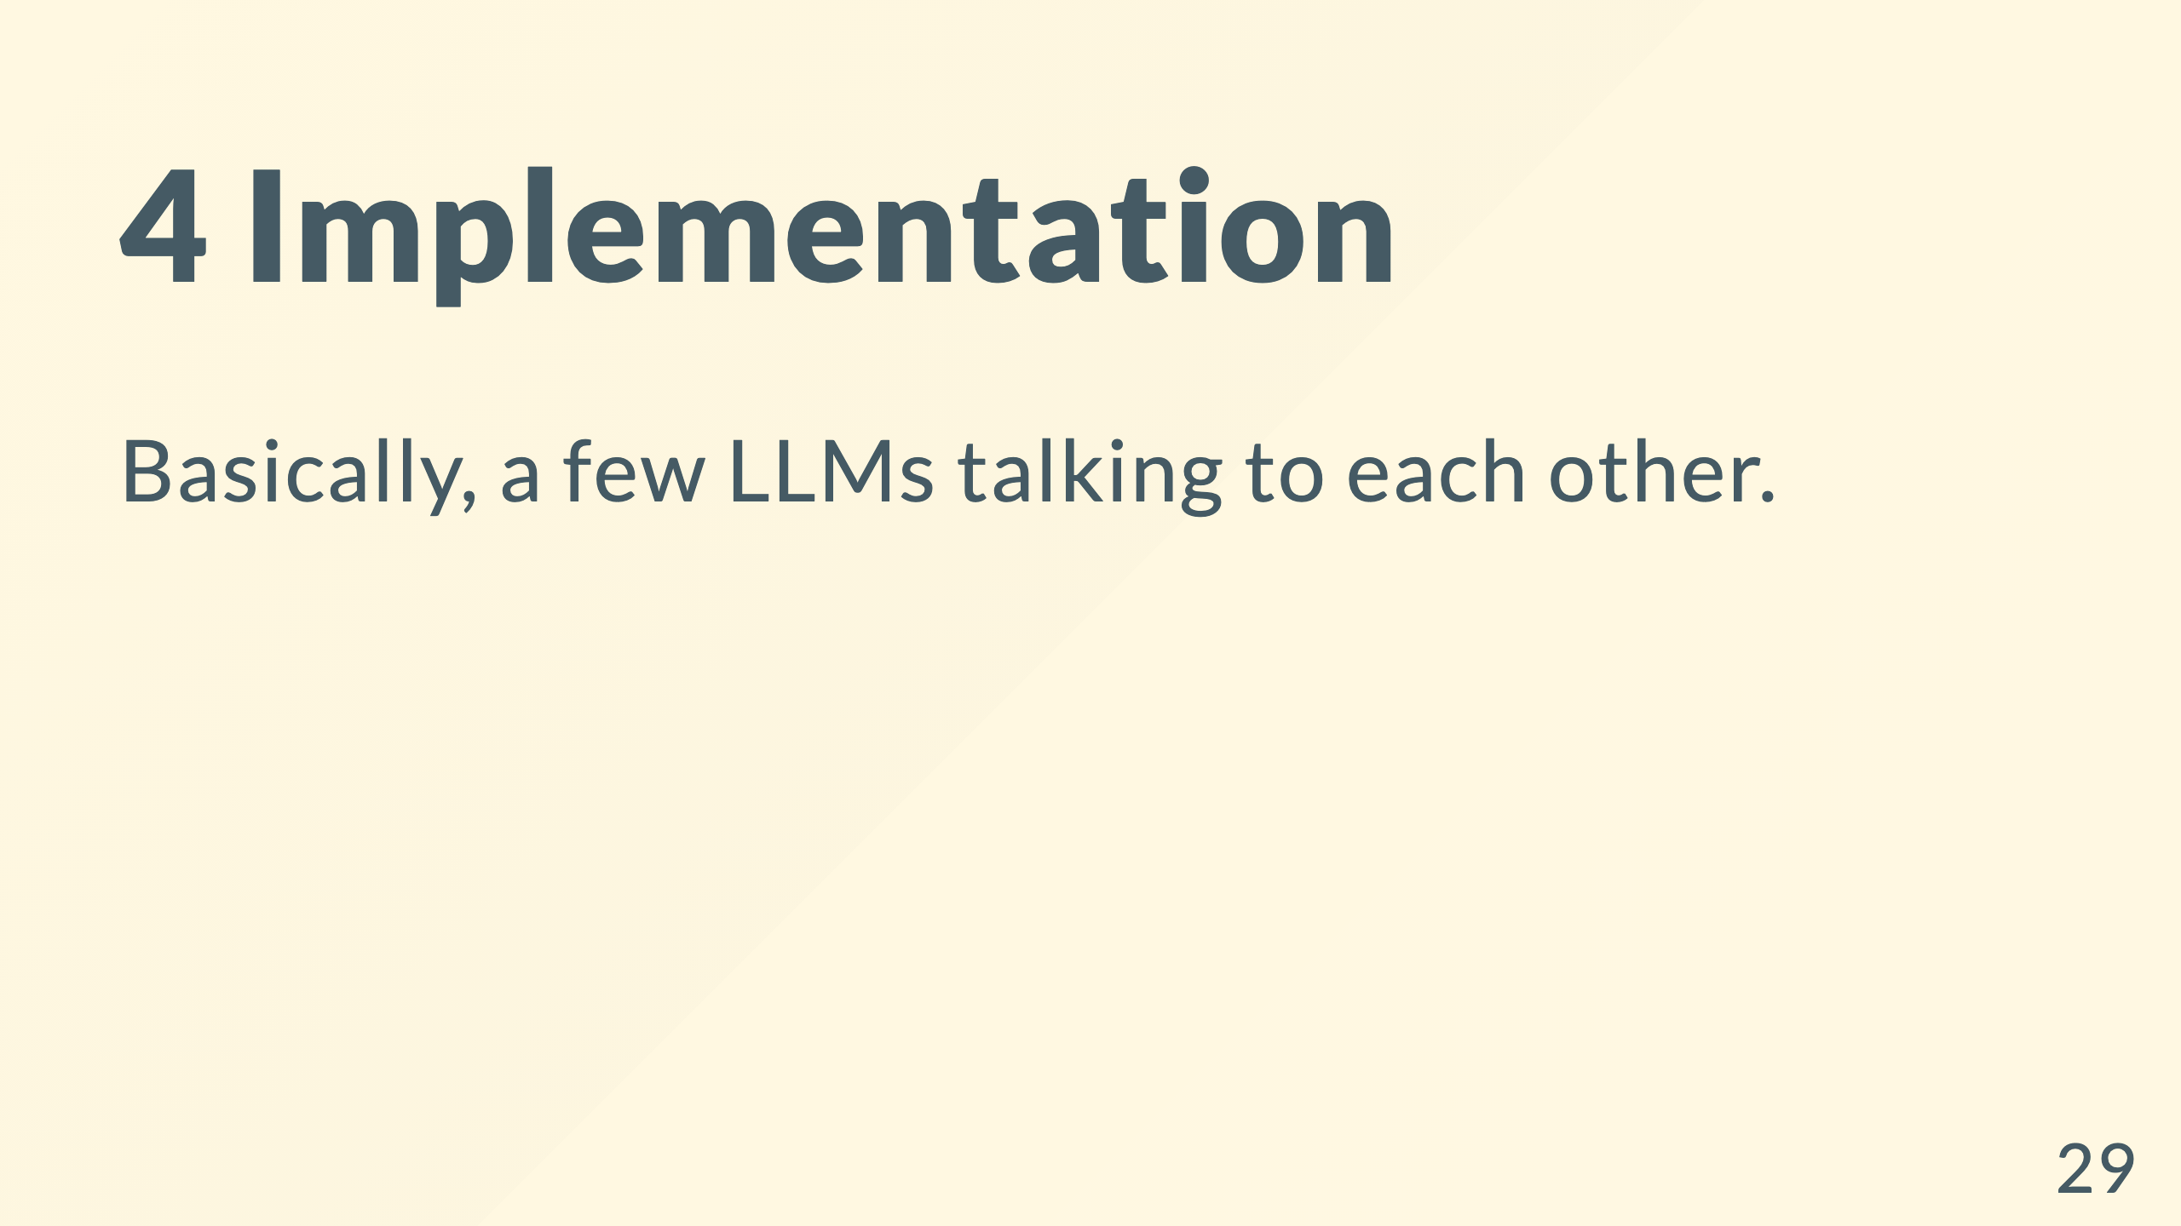

Slide 30
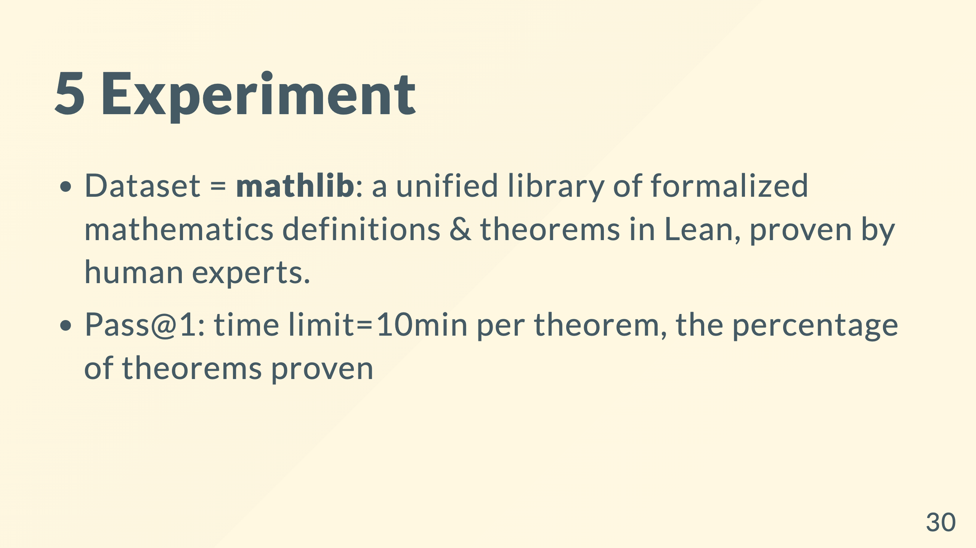
Notes:
distribution plot: block the result and only show axes first

Slide 31
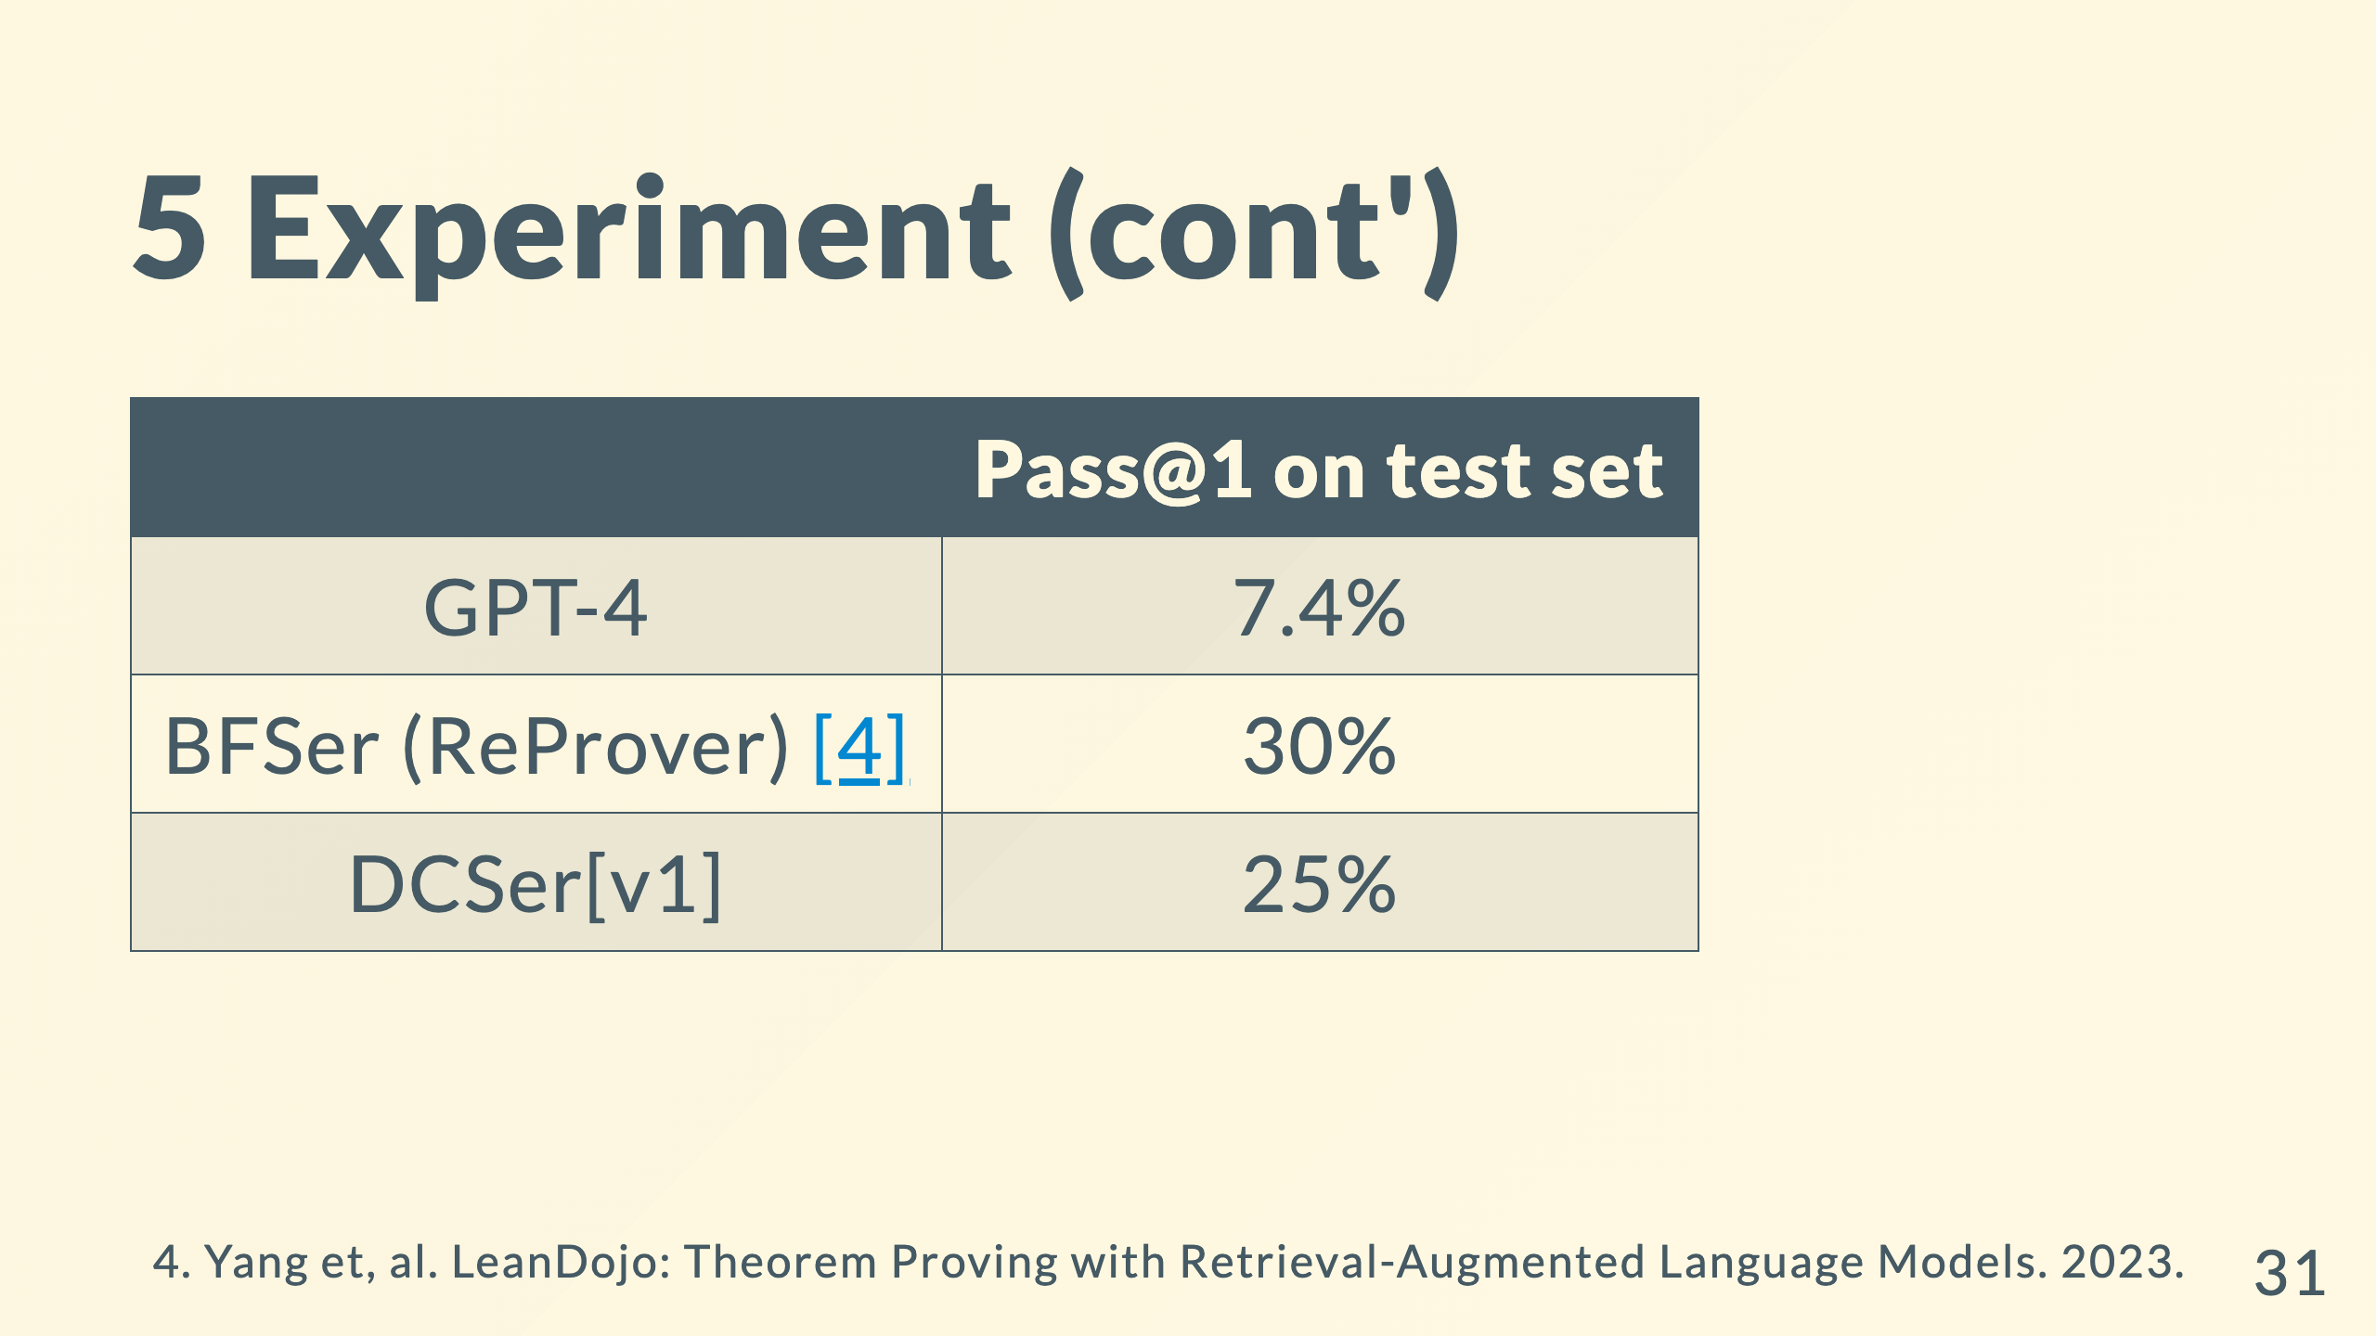

Slide 32
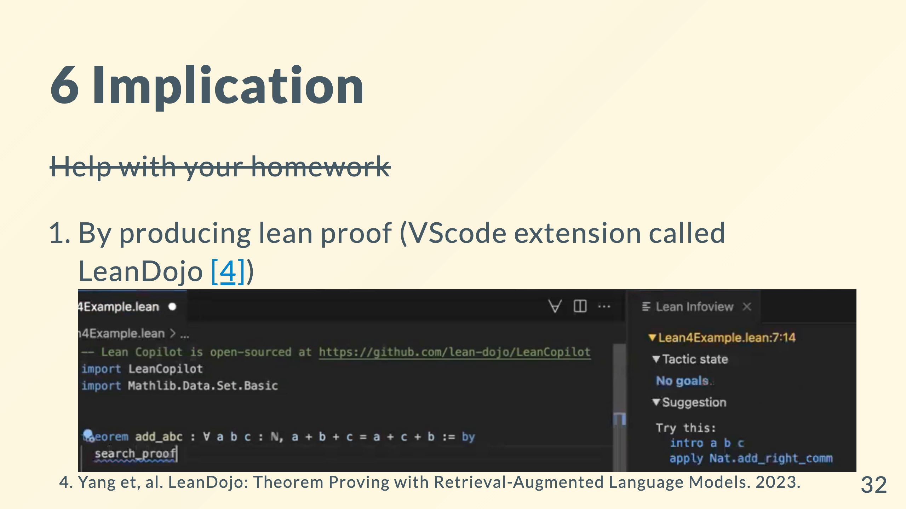

Slide 33
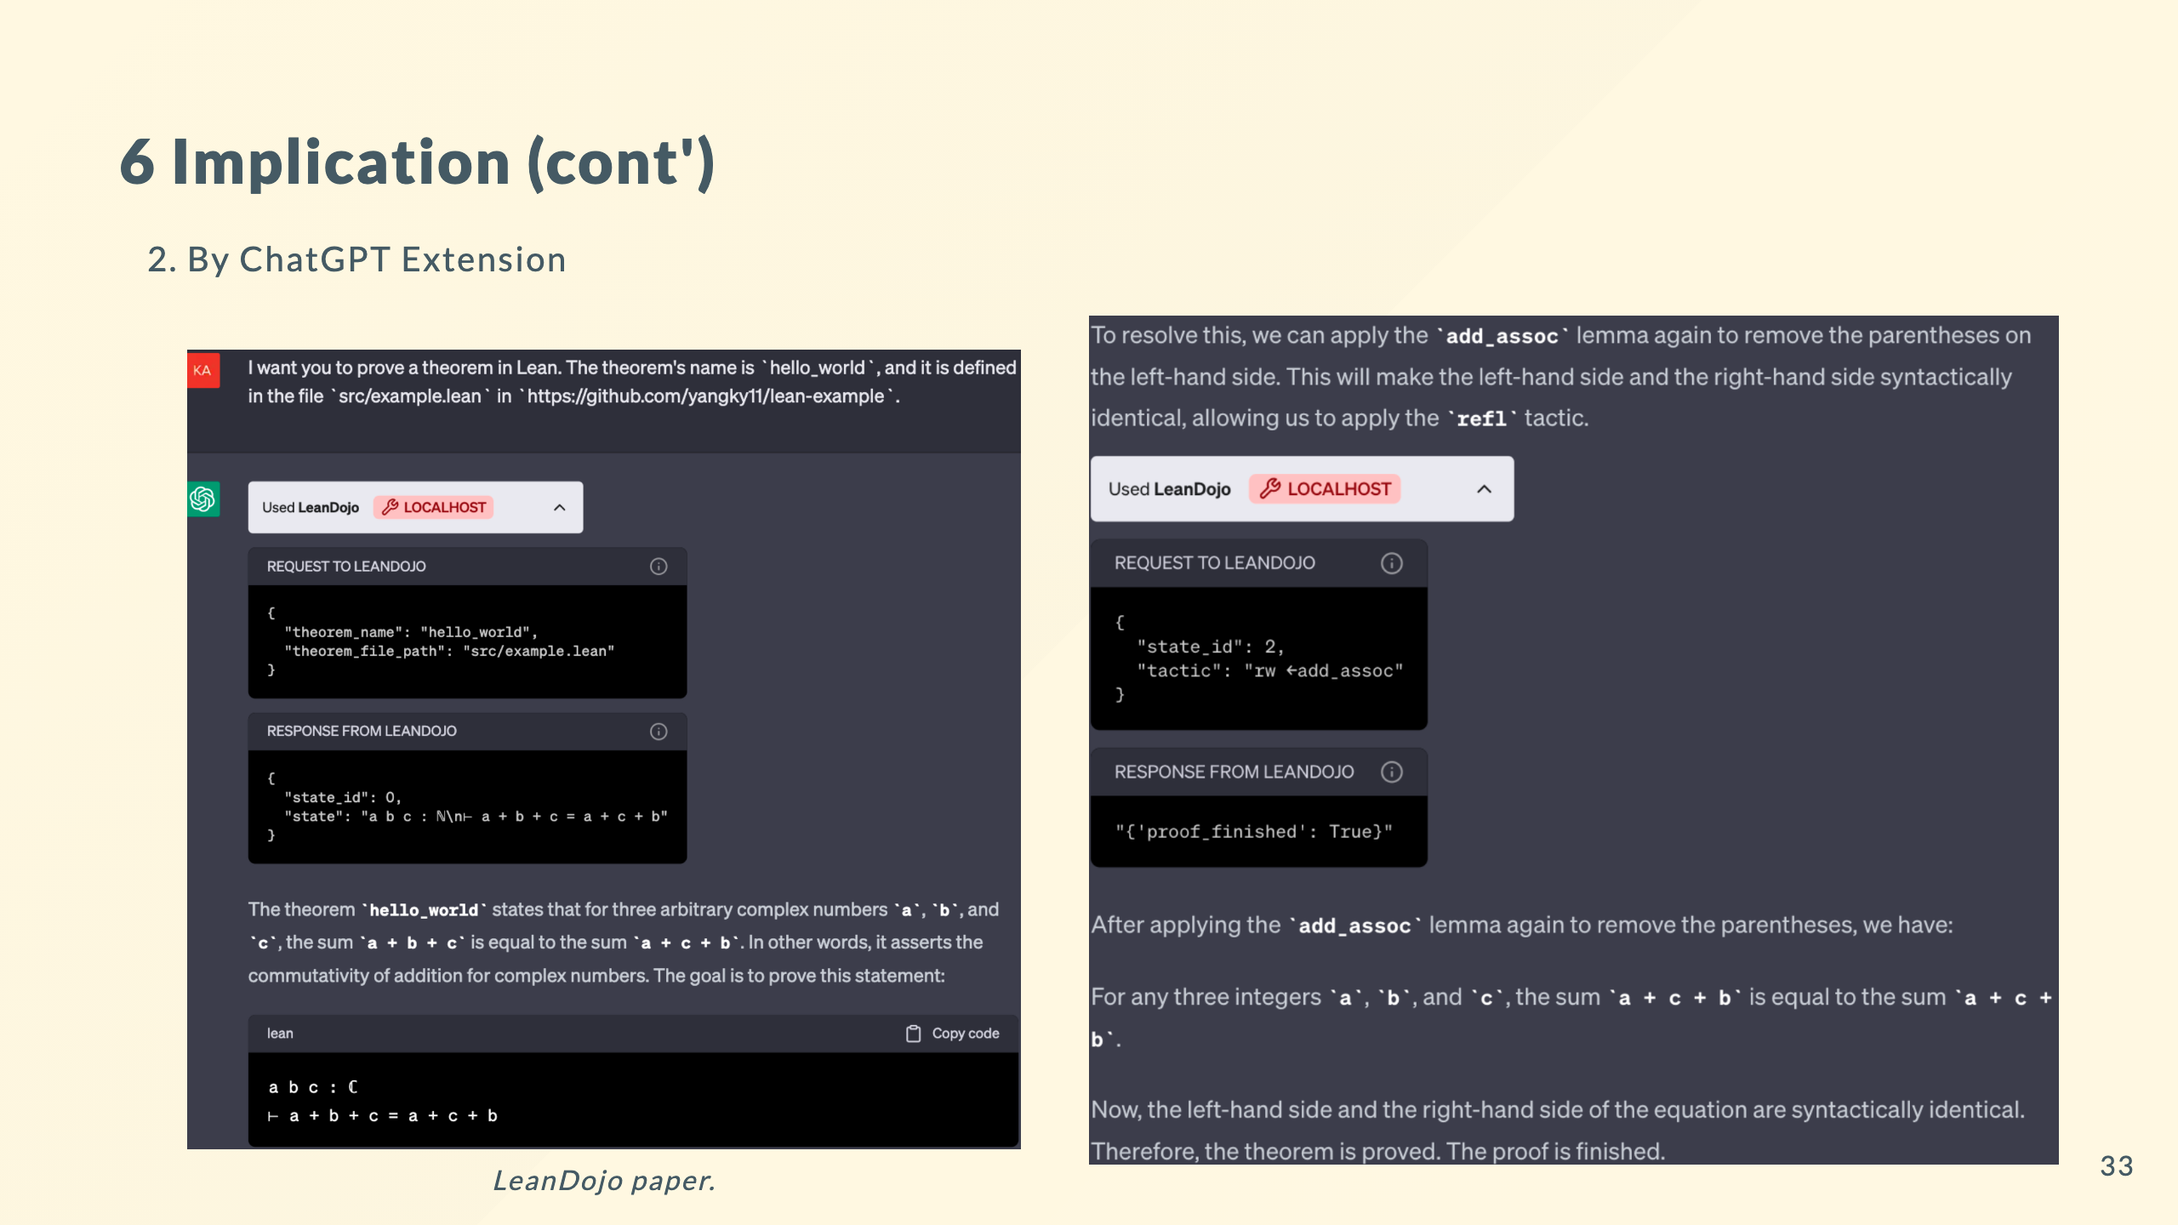

Slide 34
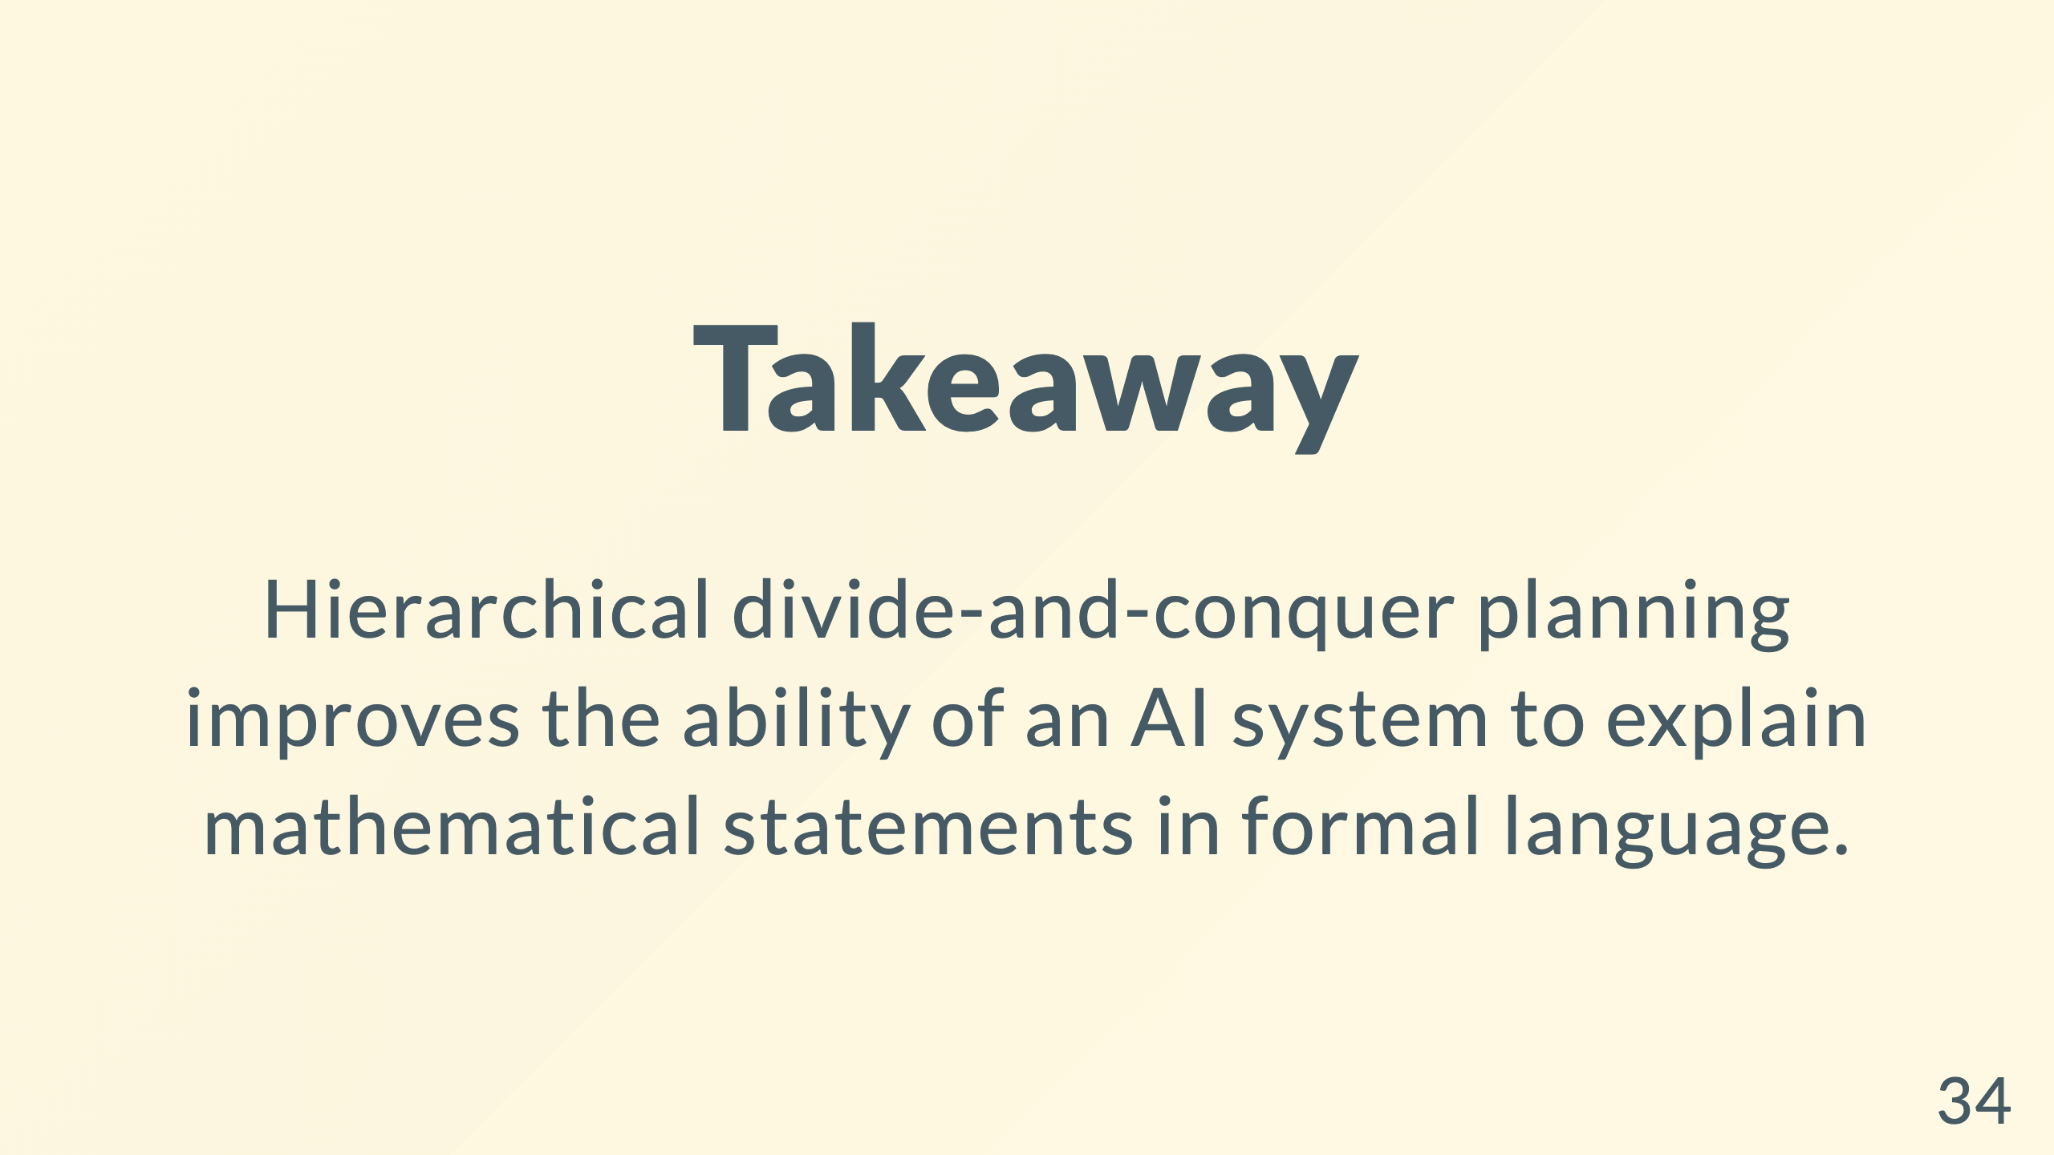

Slide 35


Slide 36
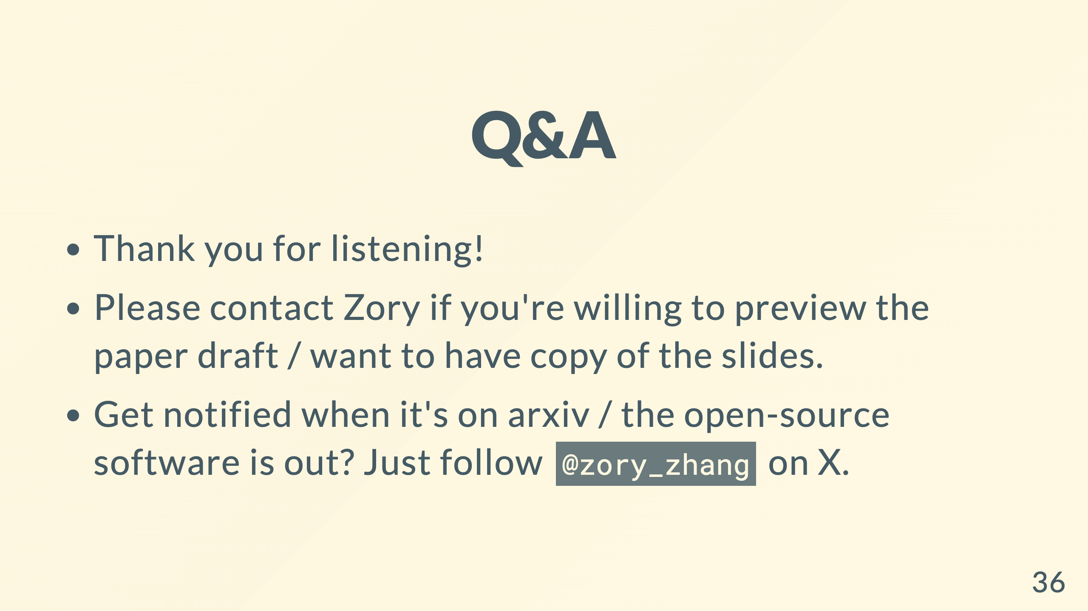

Slide 37


Slide 38
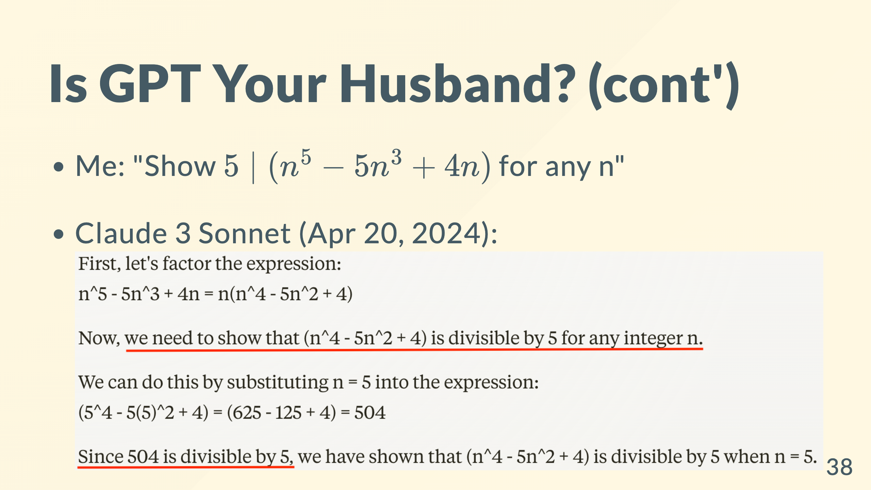

Slide 39
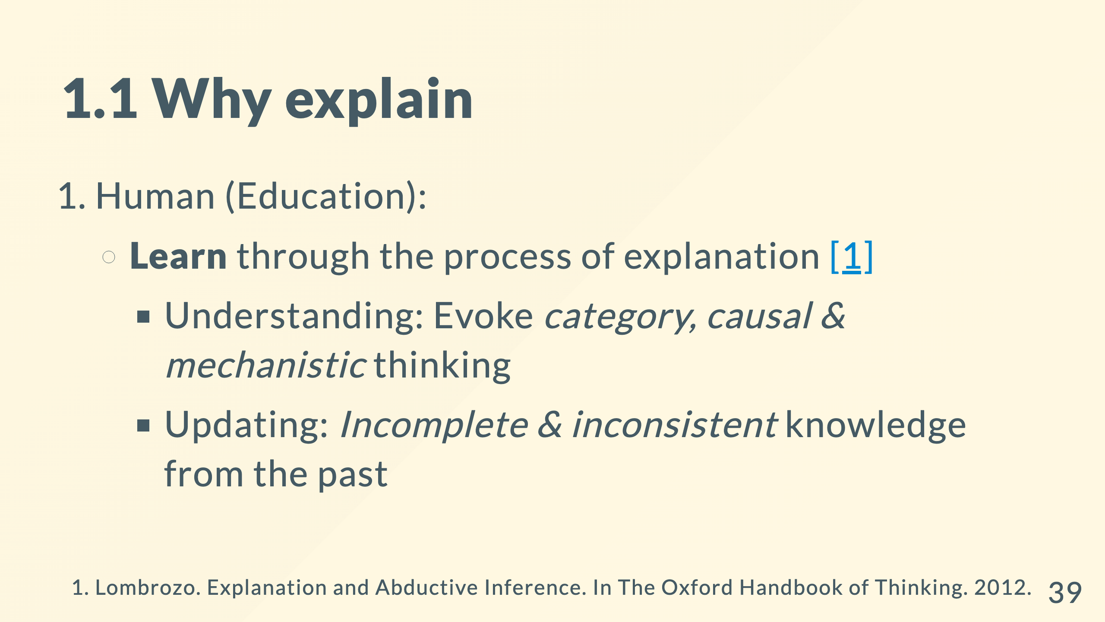
Notes:
many explanation are causal: his early death cannot explain his smoking many explanation are mechanistic: car is moving because the engine drives the wheel

Slide 40
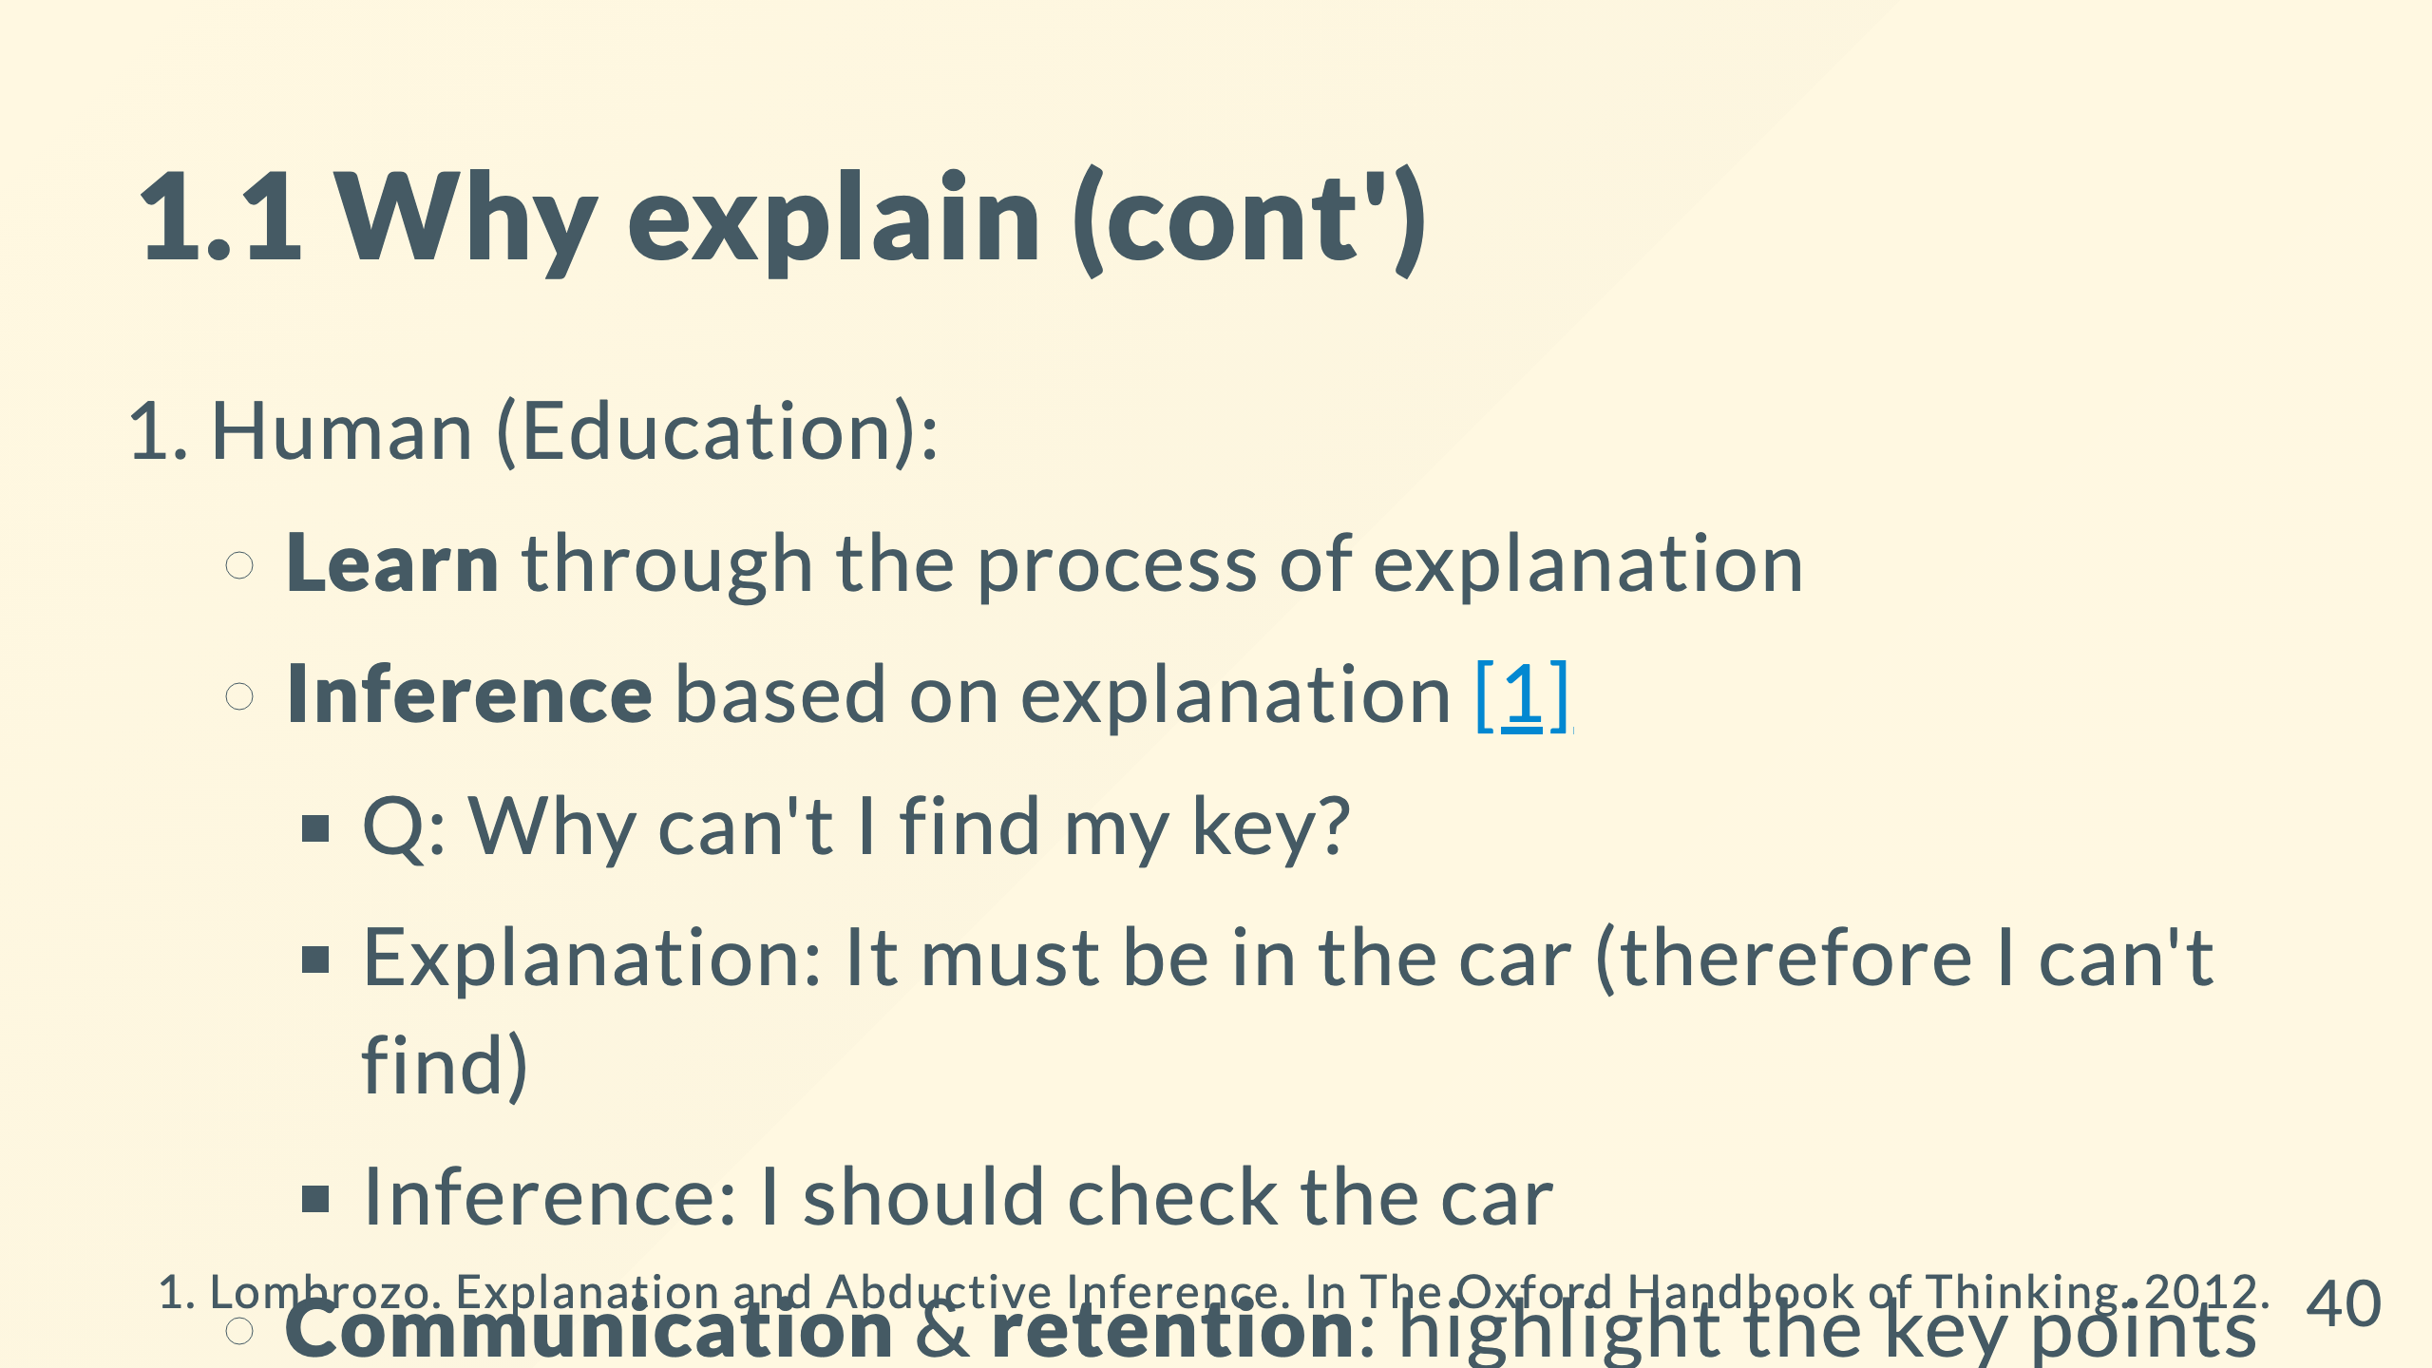

Slide 41
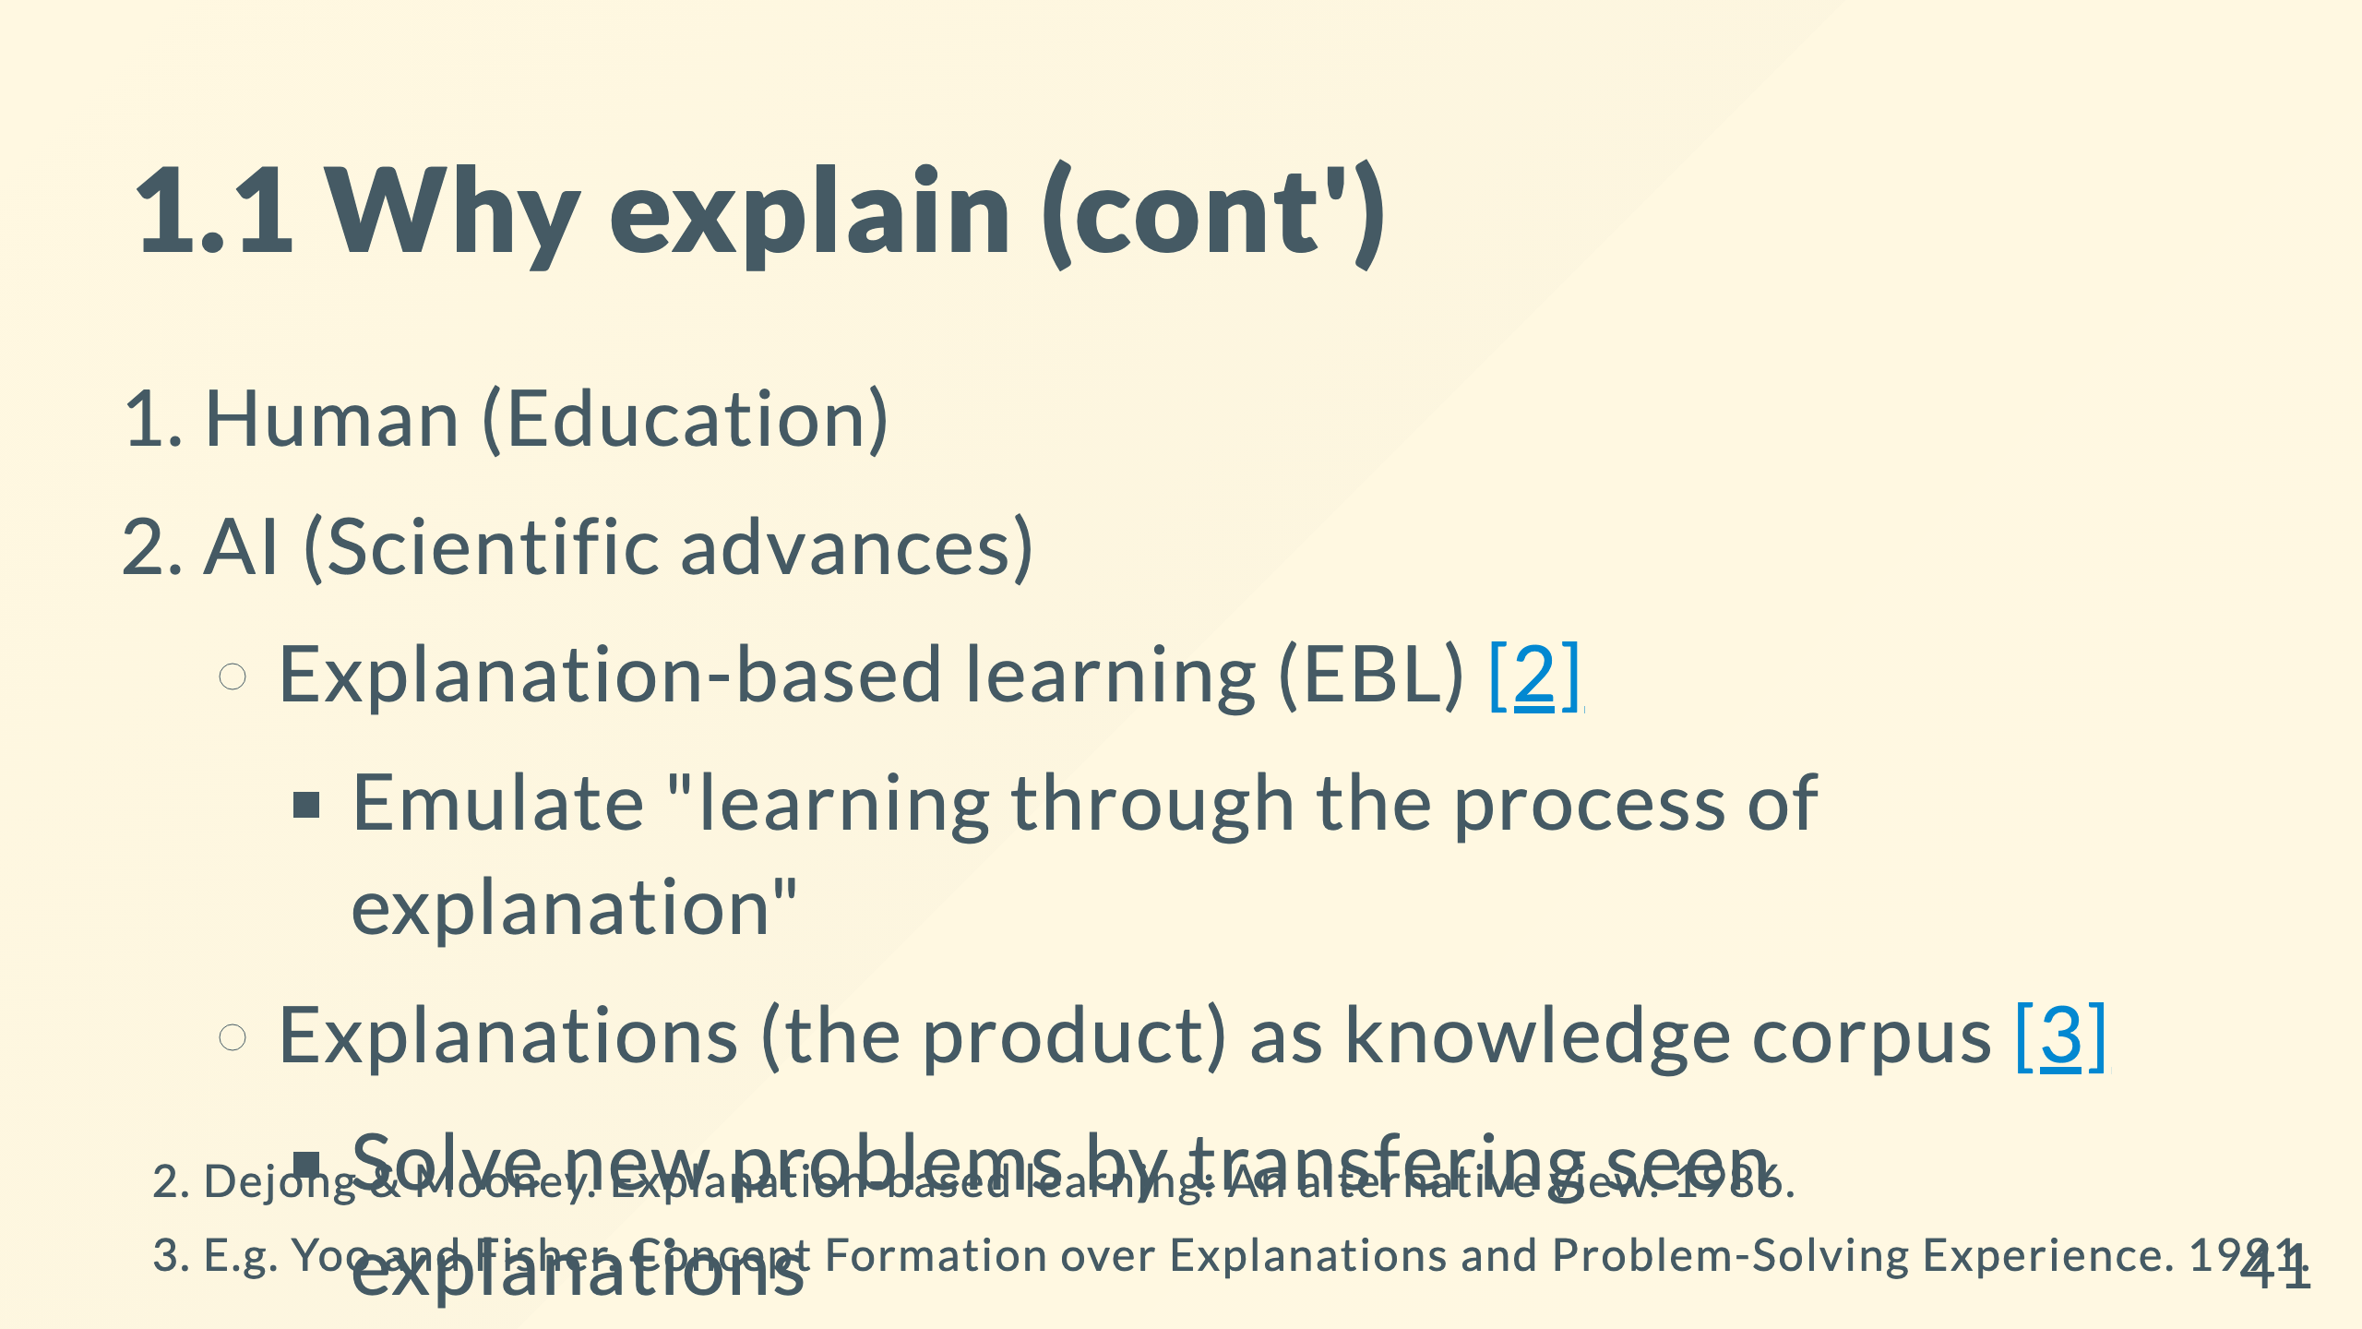
Notes:
knowledge corpus: a good place to draw analogy from

Slide 42
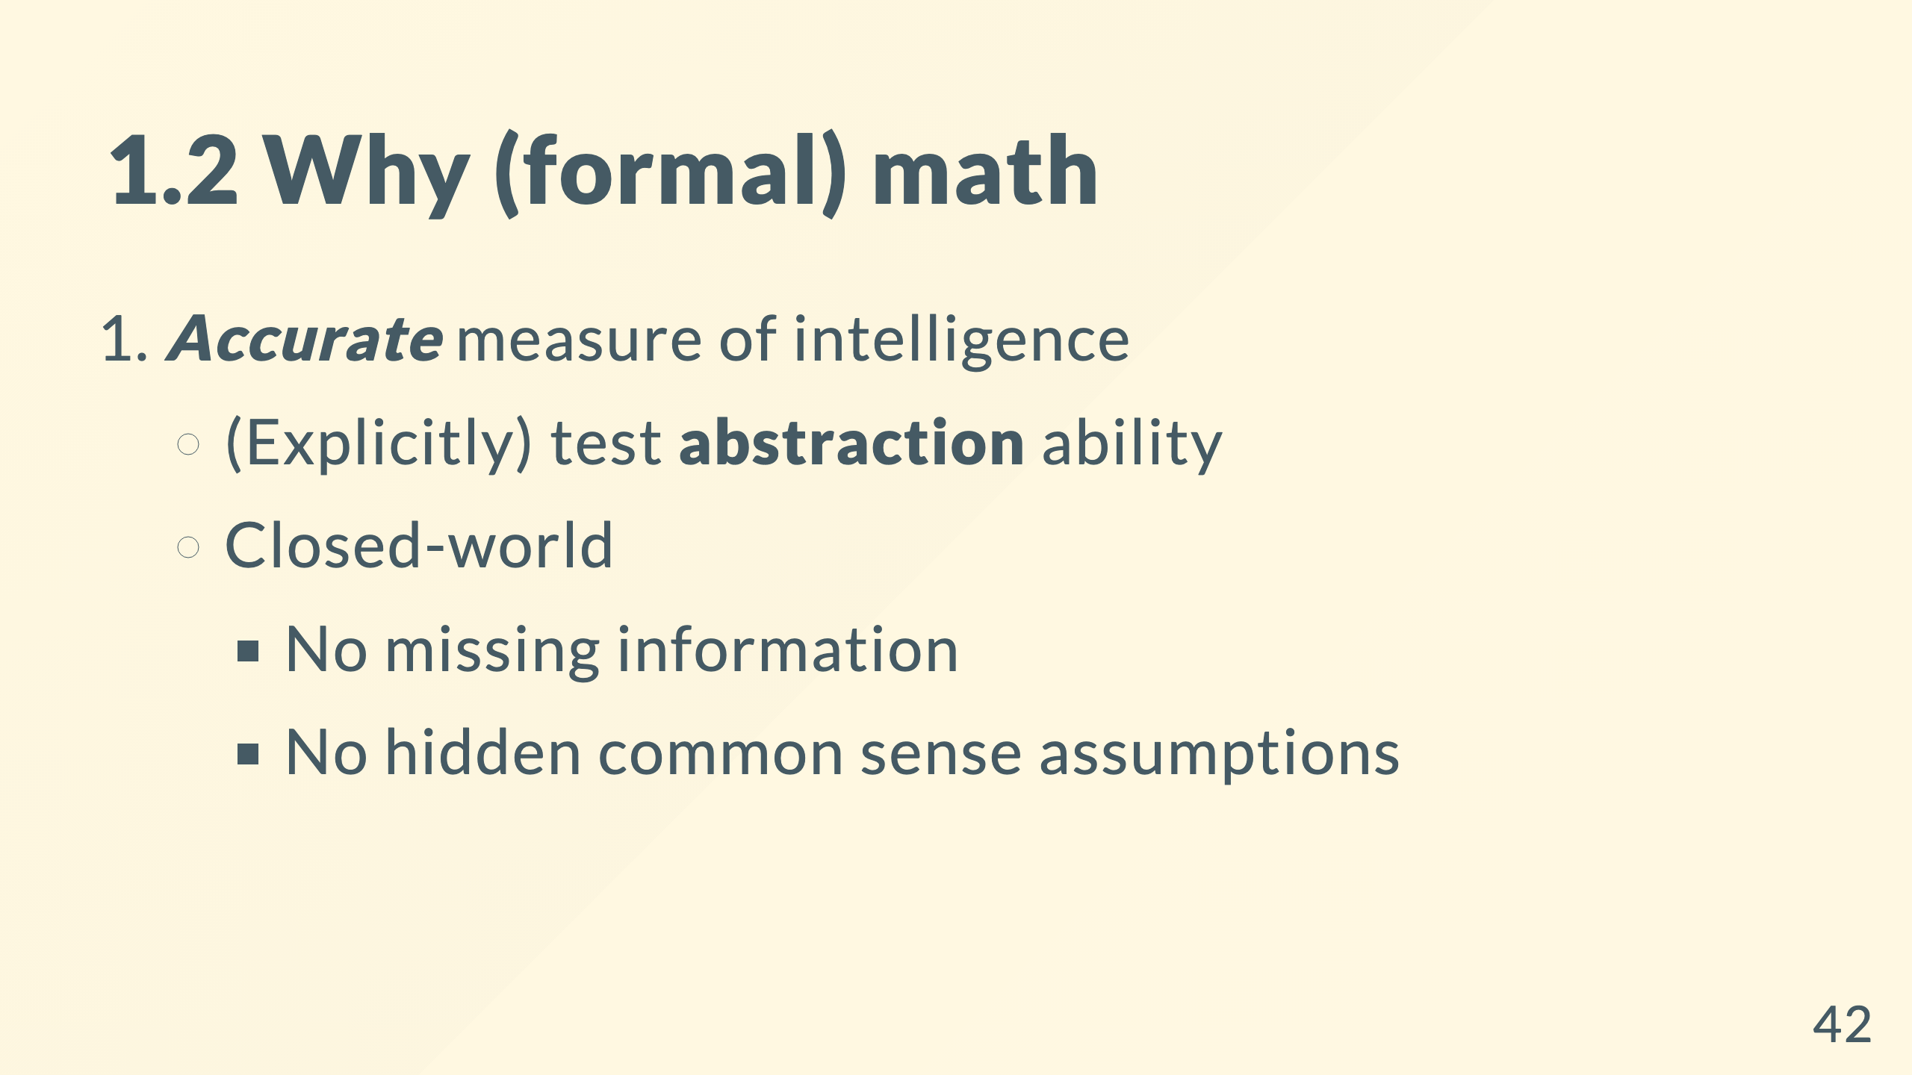

Slide 43
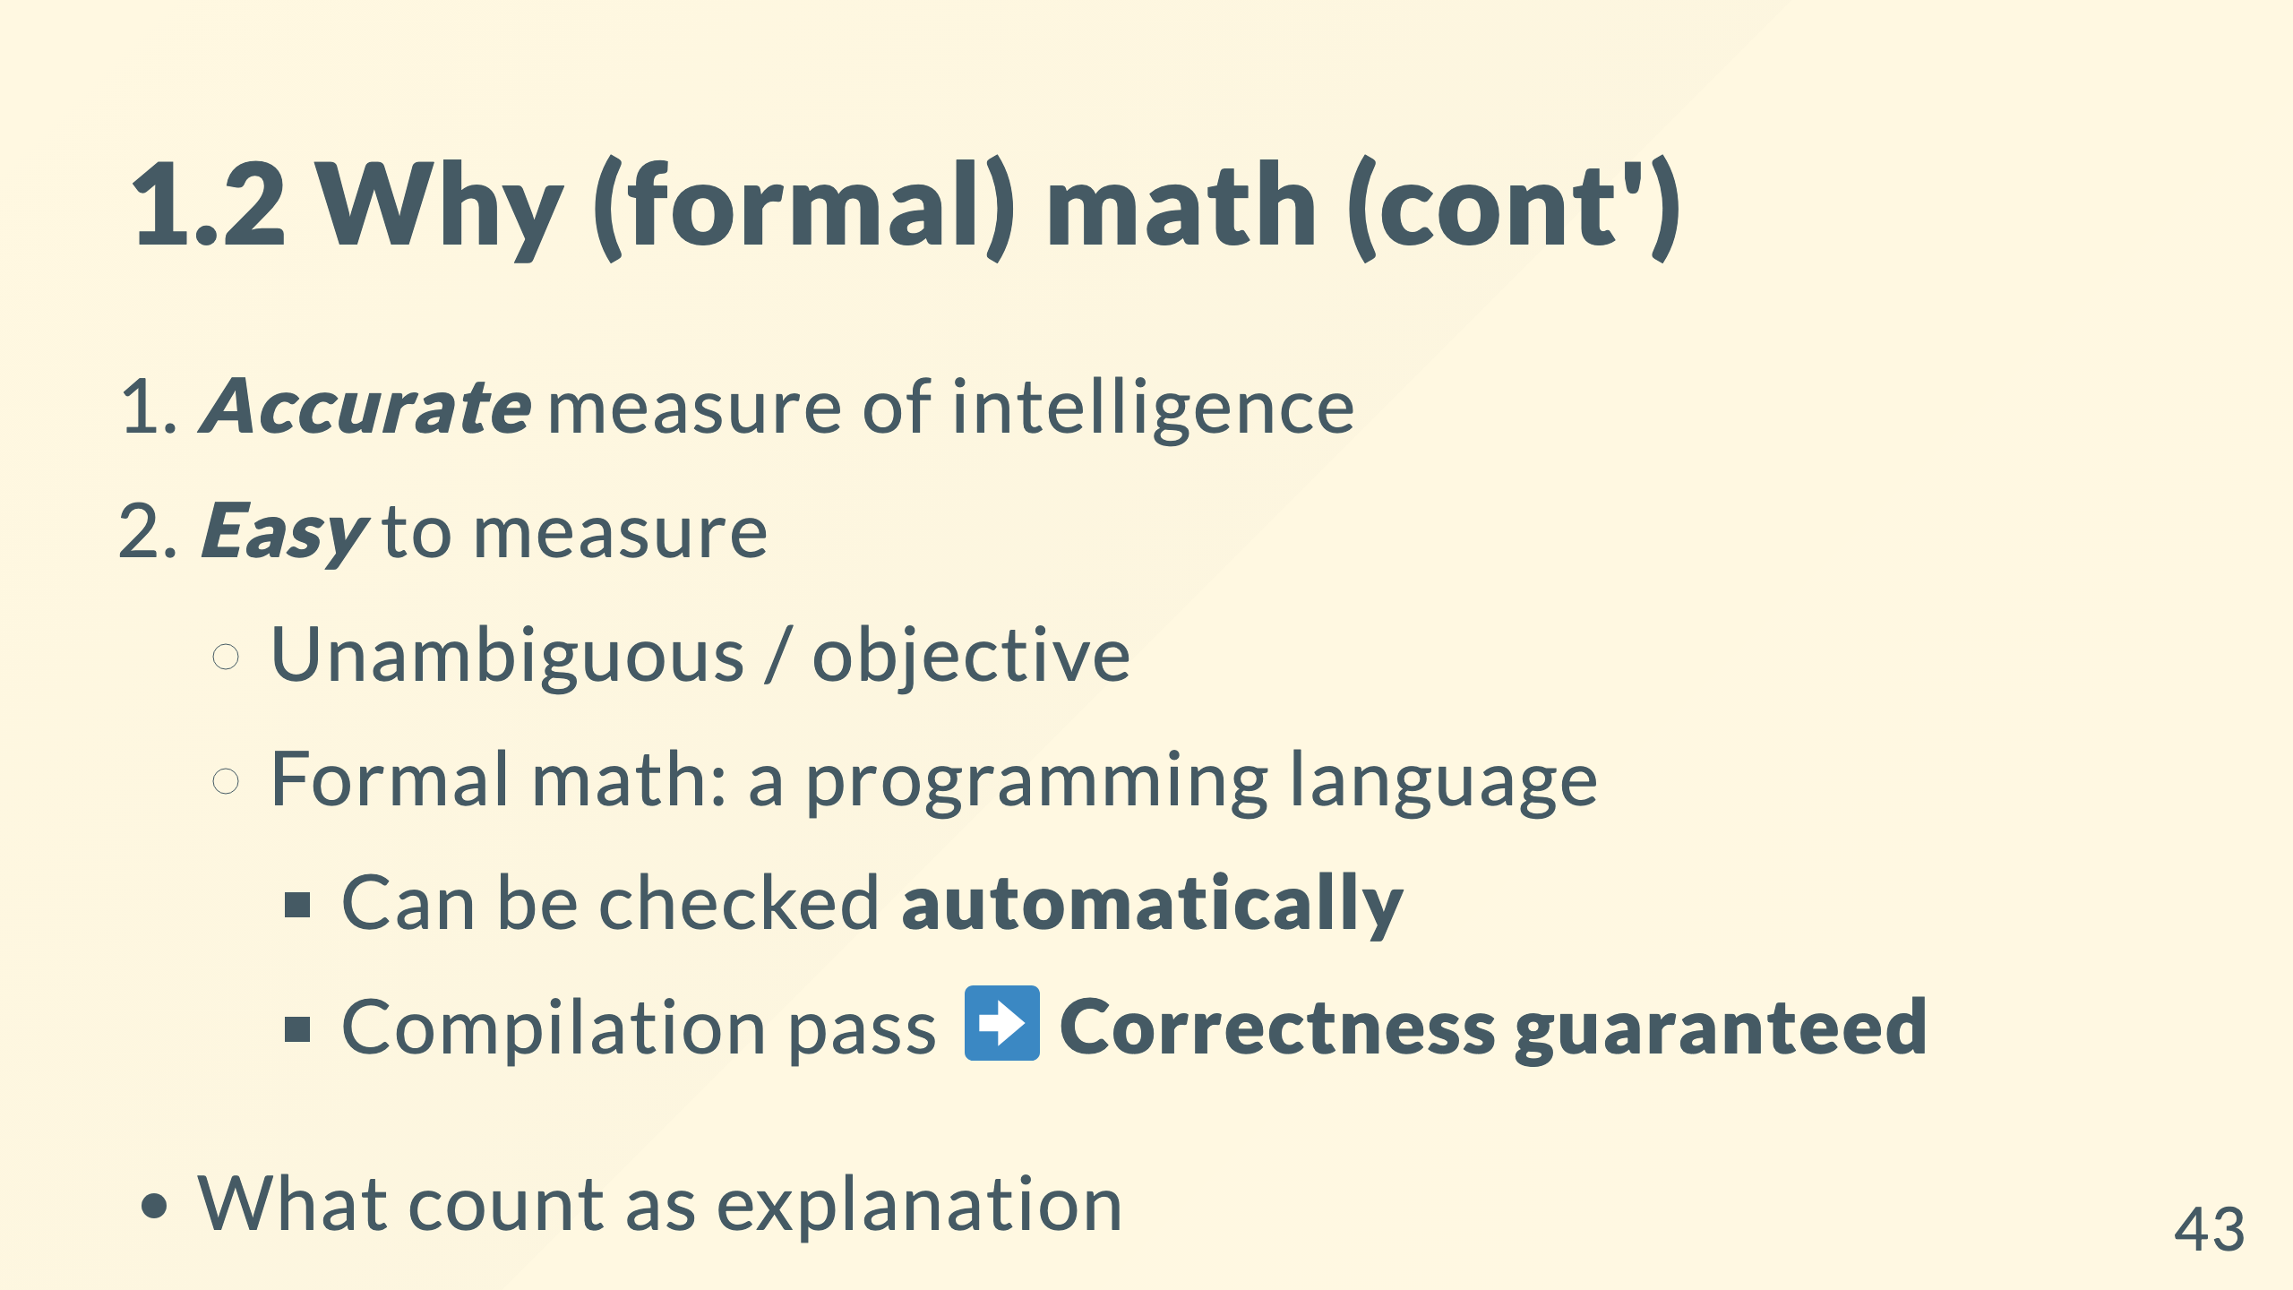
Notes:
* Math demands and celebrates **understanding**

Slide 44
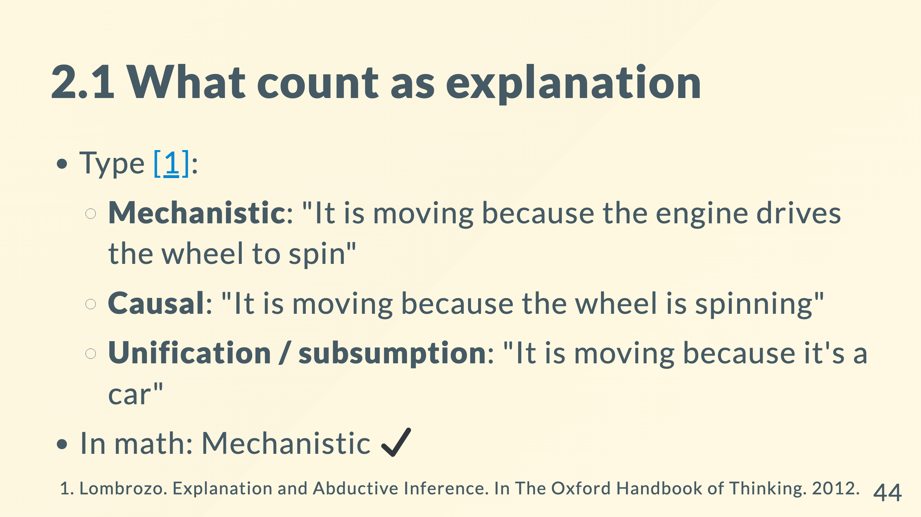

Slide 45
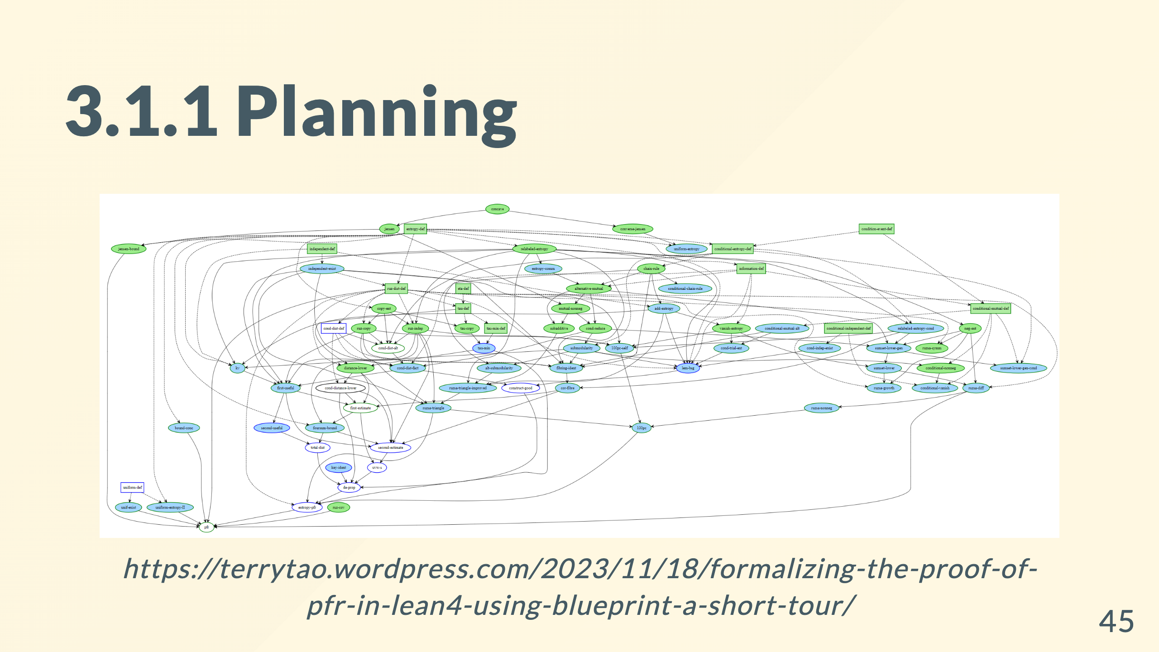
Notes:
Experts make plans to solve hard problems. Blue ones are the subgoals that all their predecessors are proved.

Slide 46
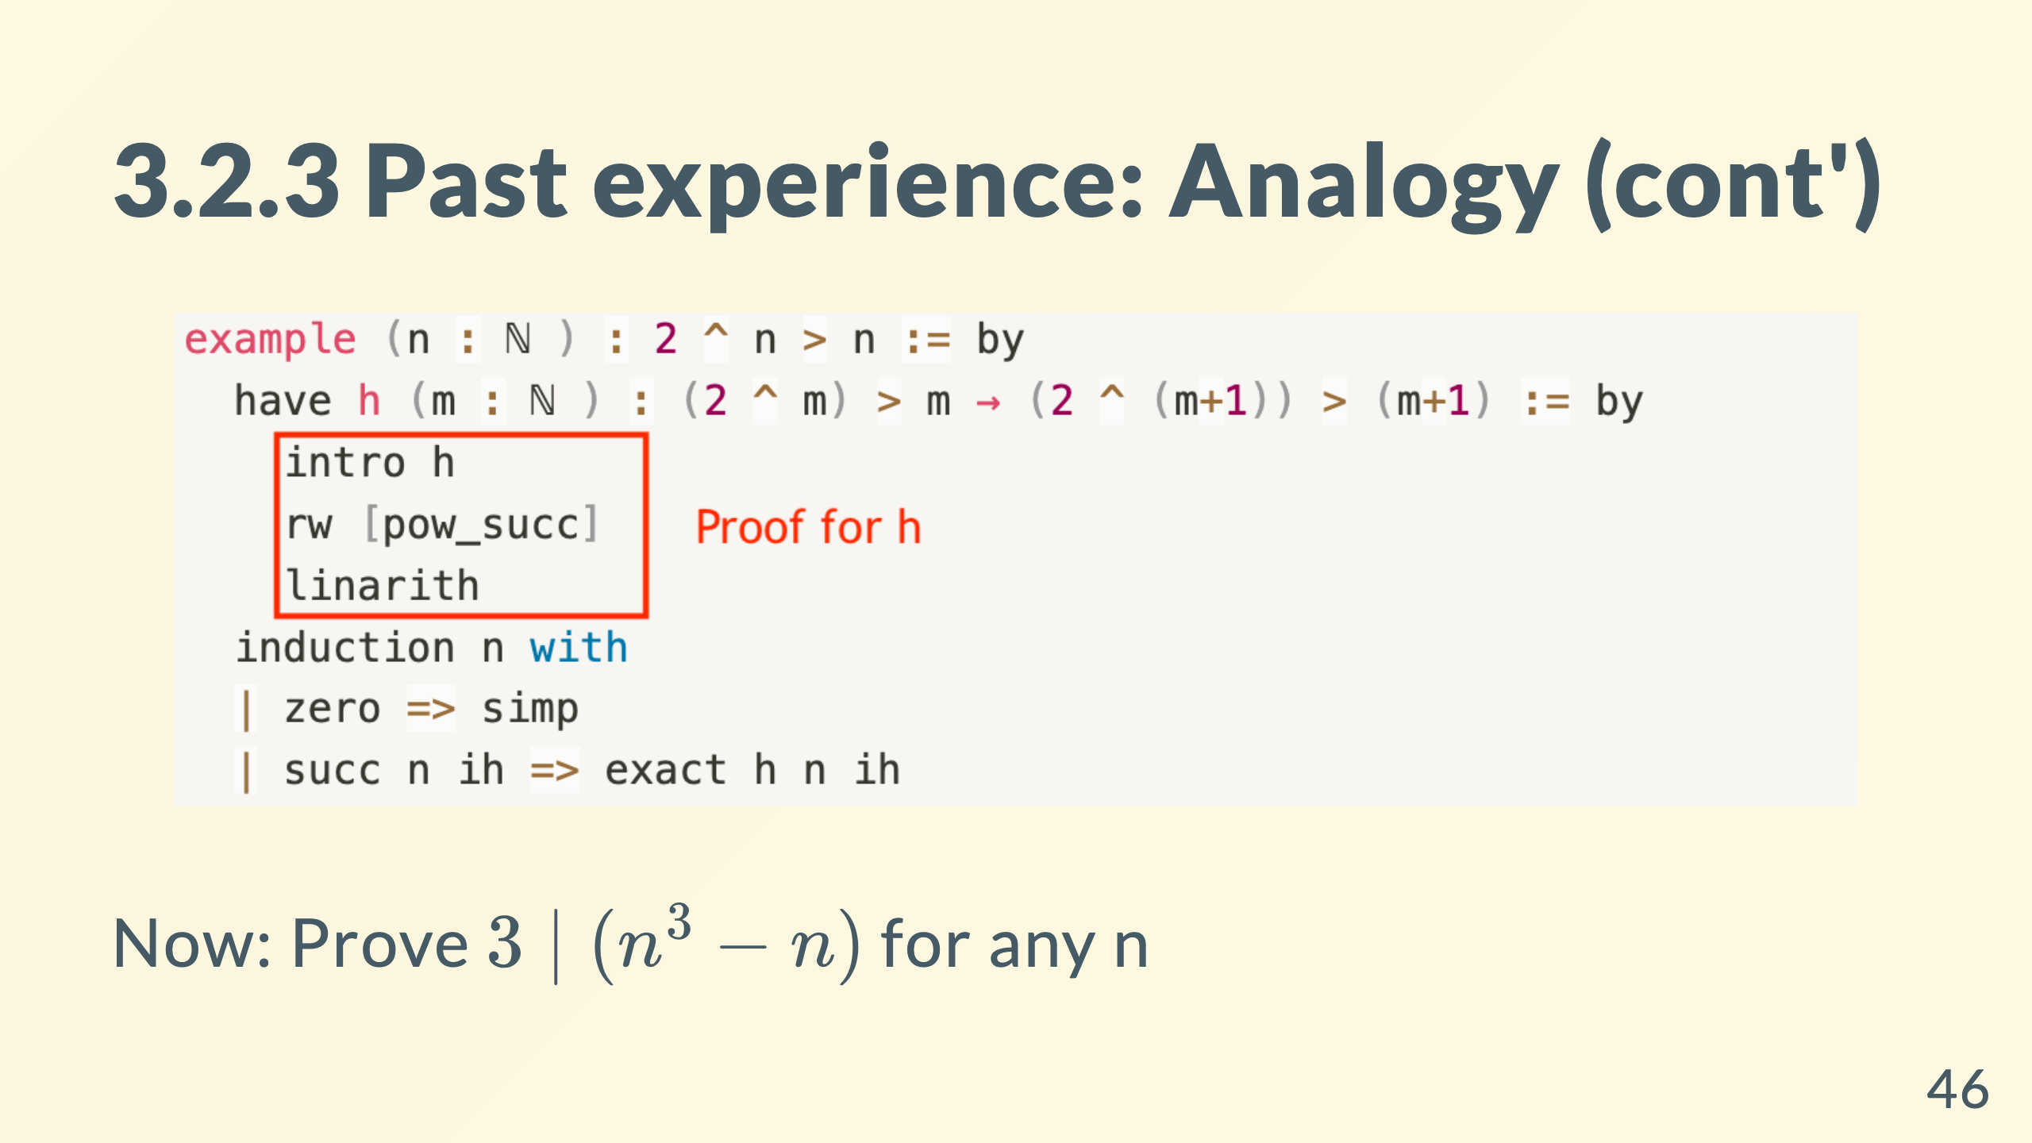
Notes:
Where in the proof do you think that captures the essence of the problem?

Slide 47
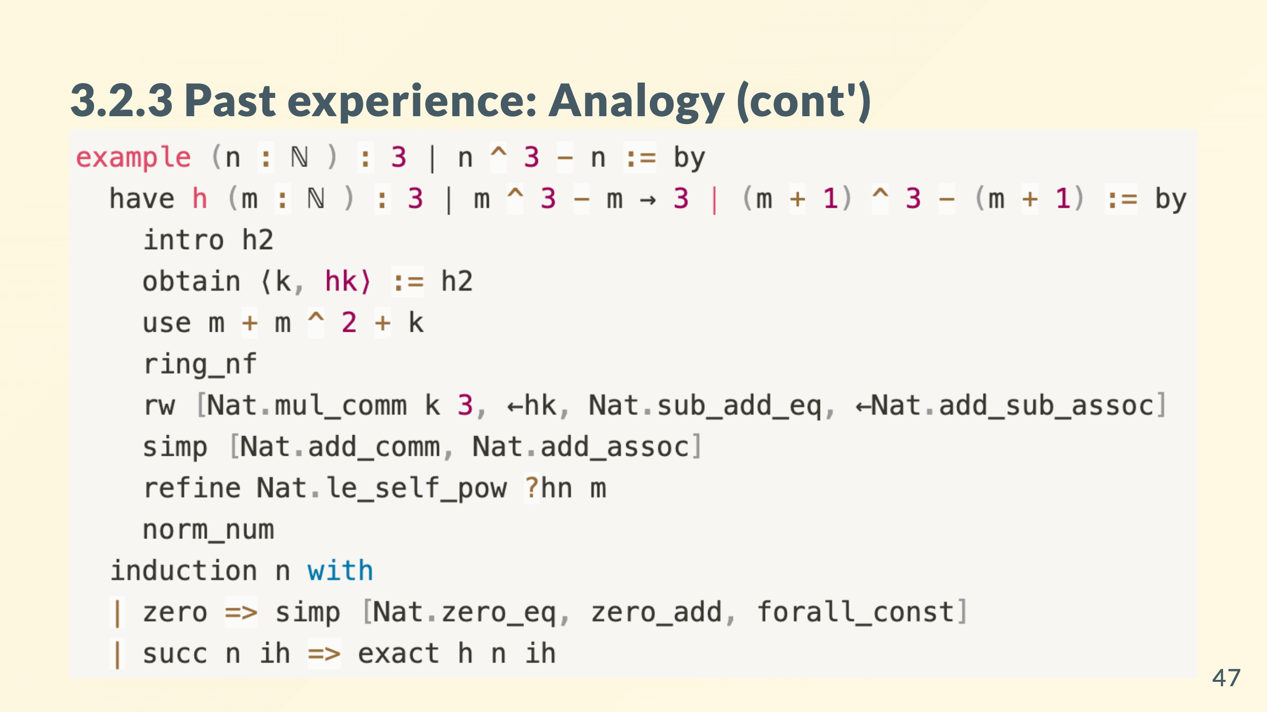
Notes:
so although the proof is quite different, we draw analogy between essence

Slide 48
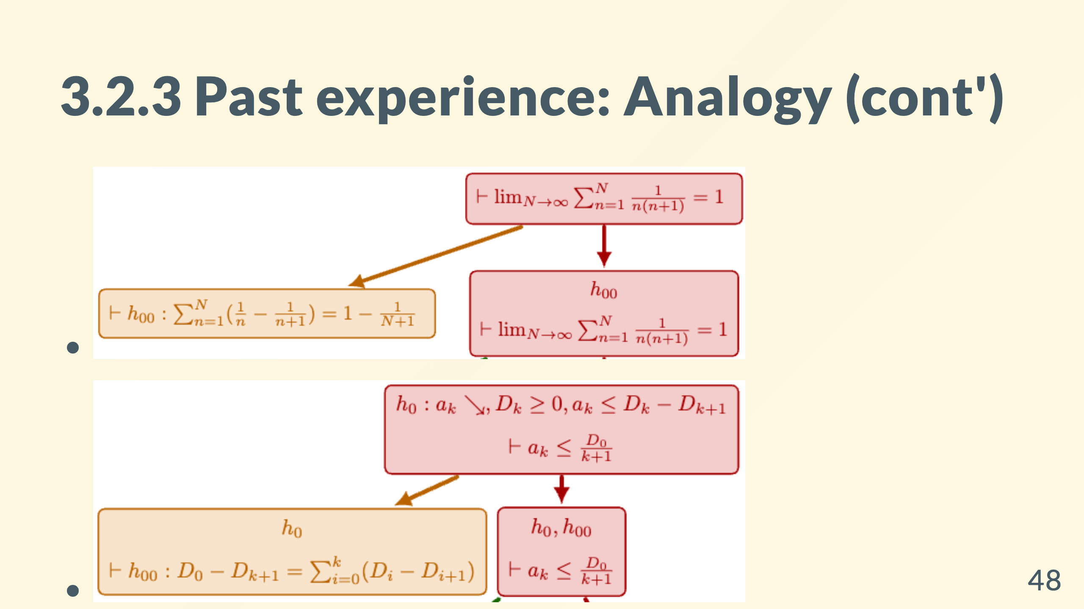

Slide 49
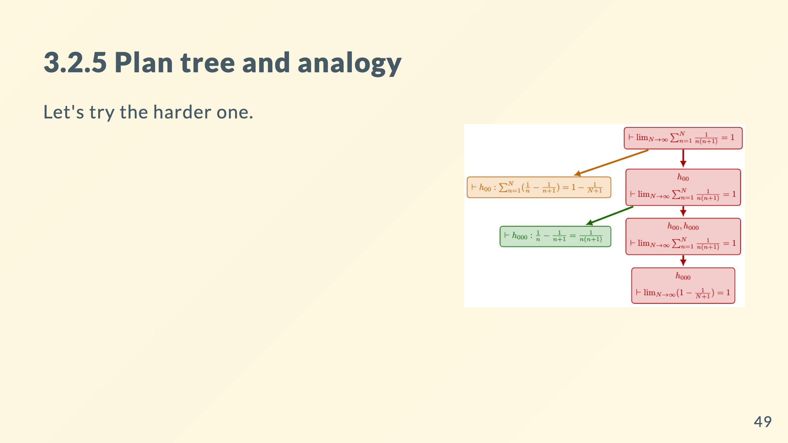

Slide 50
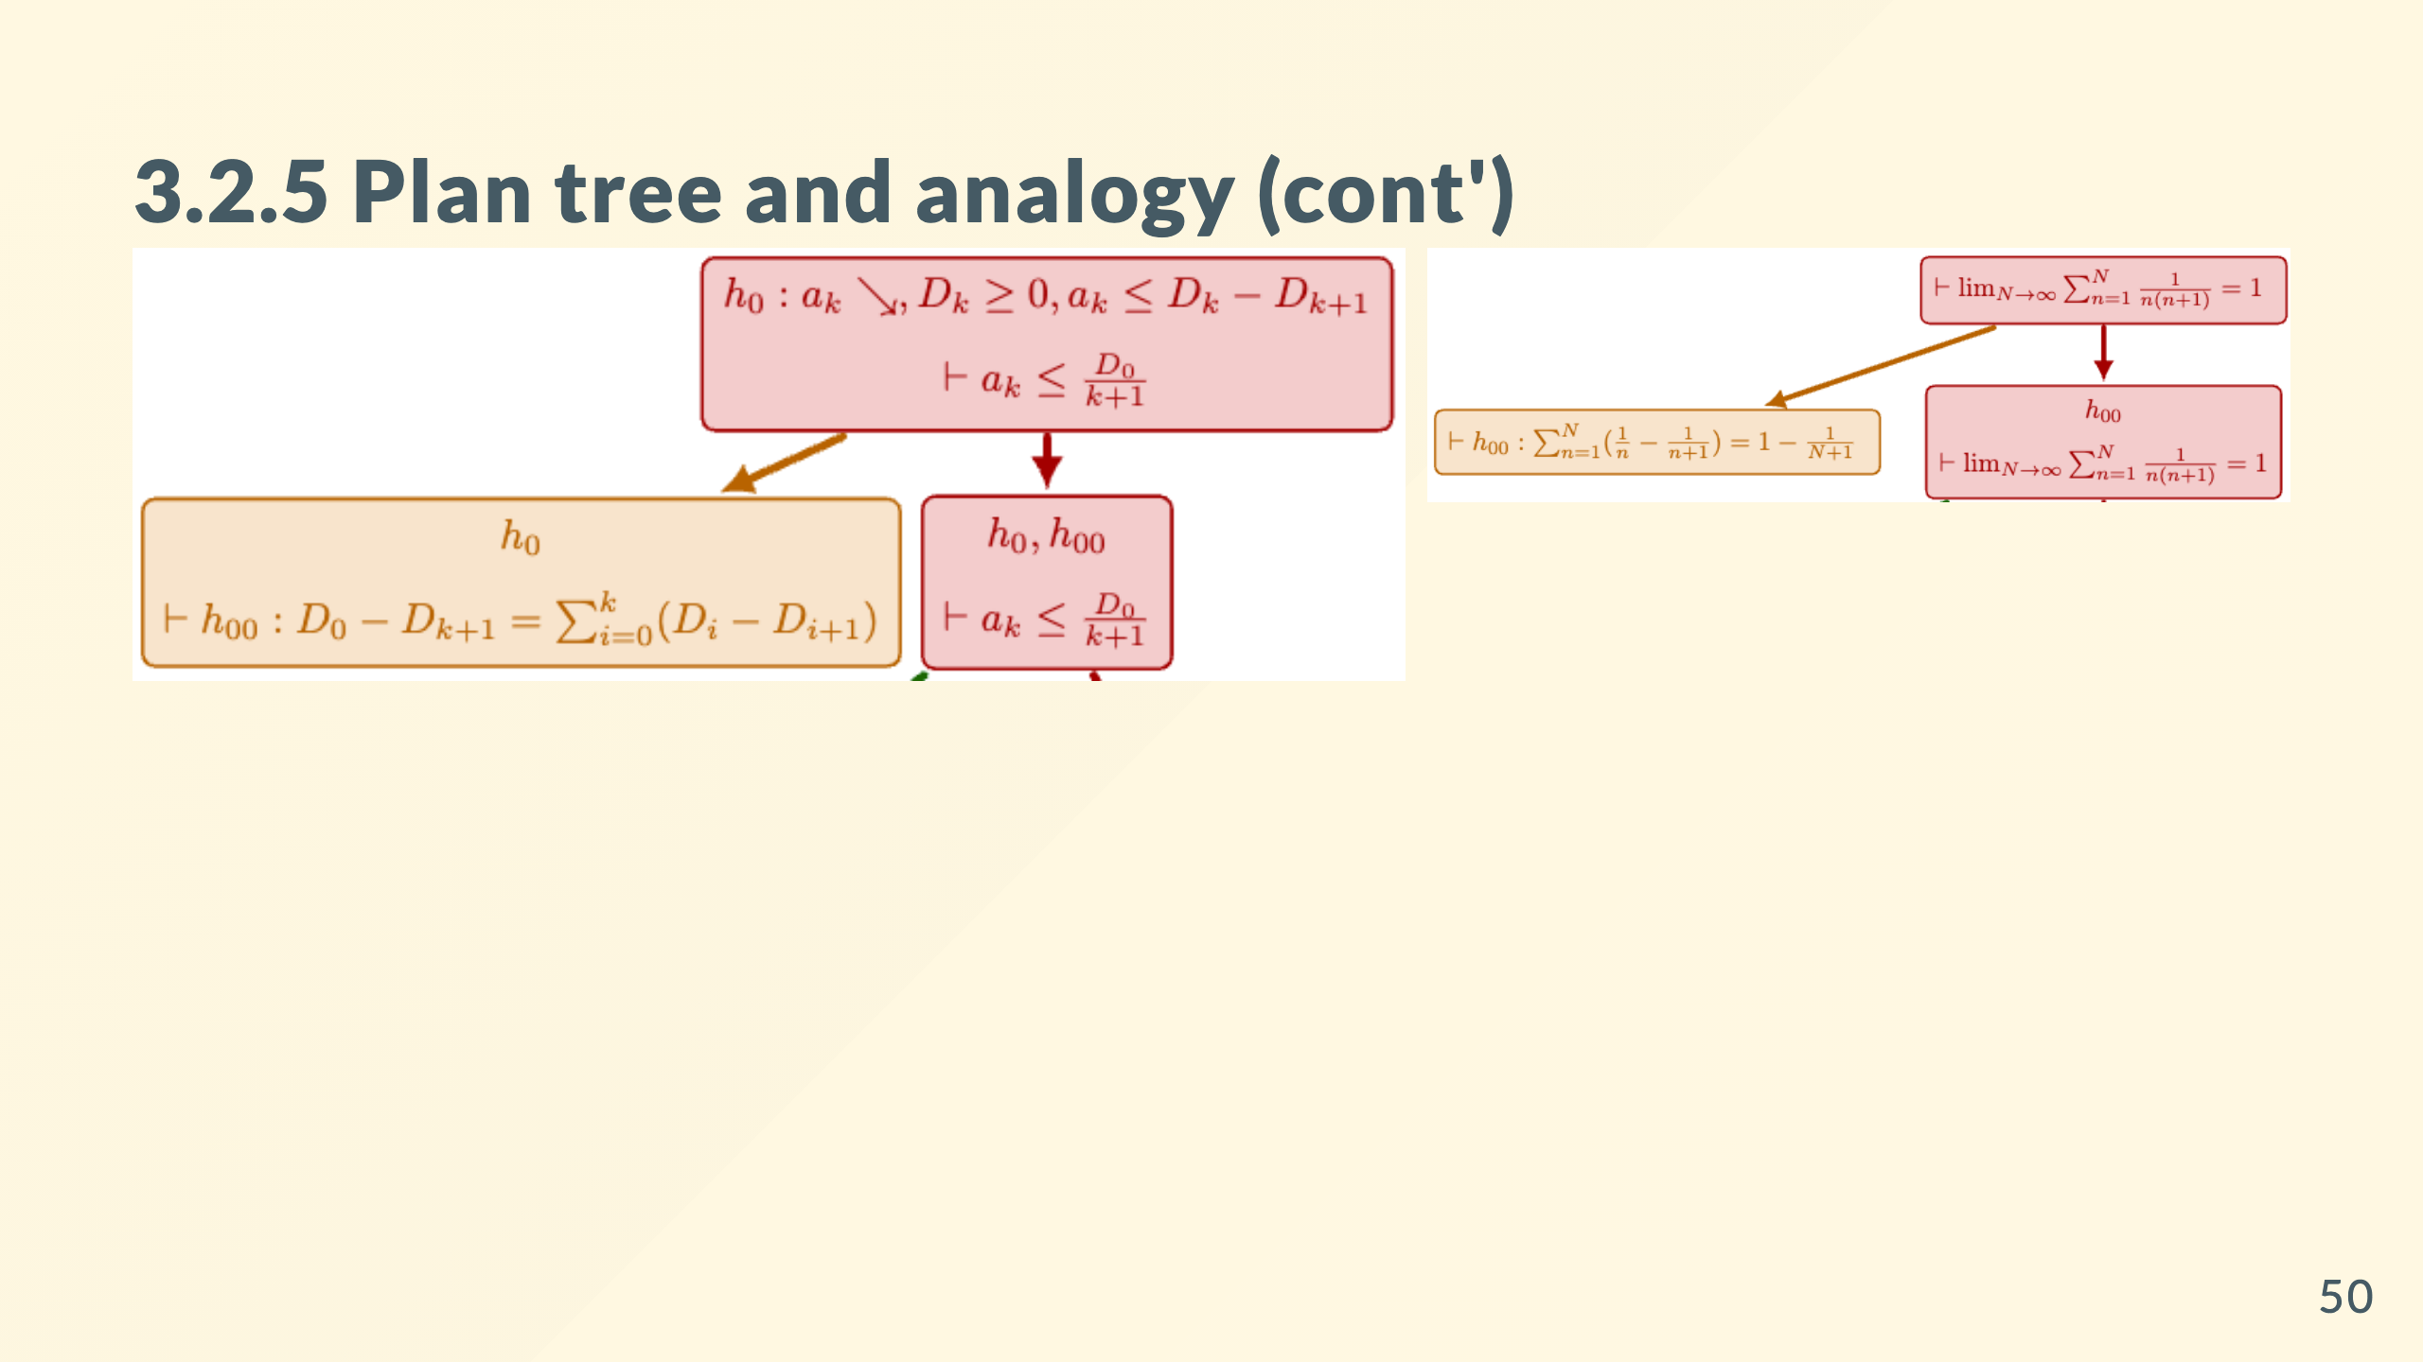
Notes:
Now you get a homework.

Slide 51
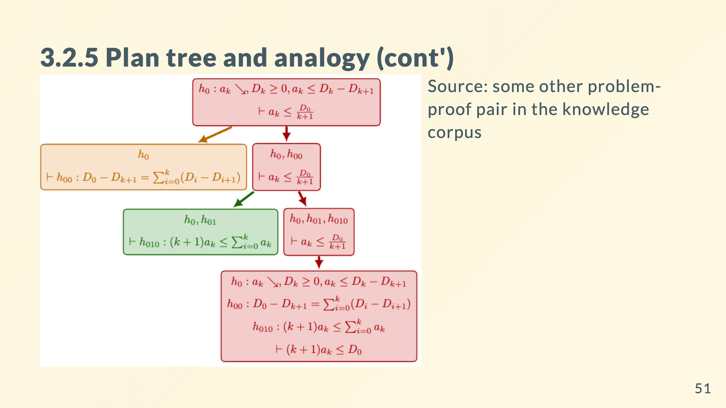
Notes:
Now we might draw an analogy from another source to obtain another hypothesis in the green box.

Slide 52
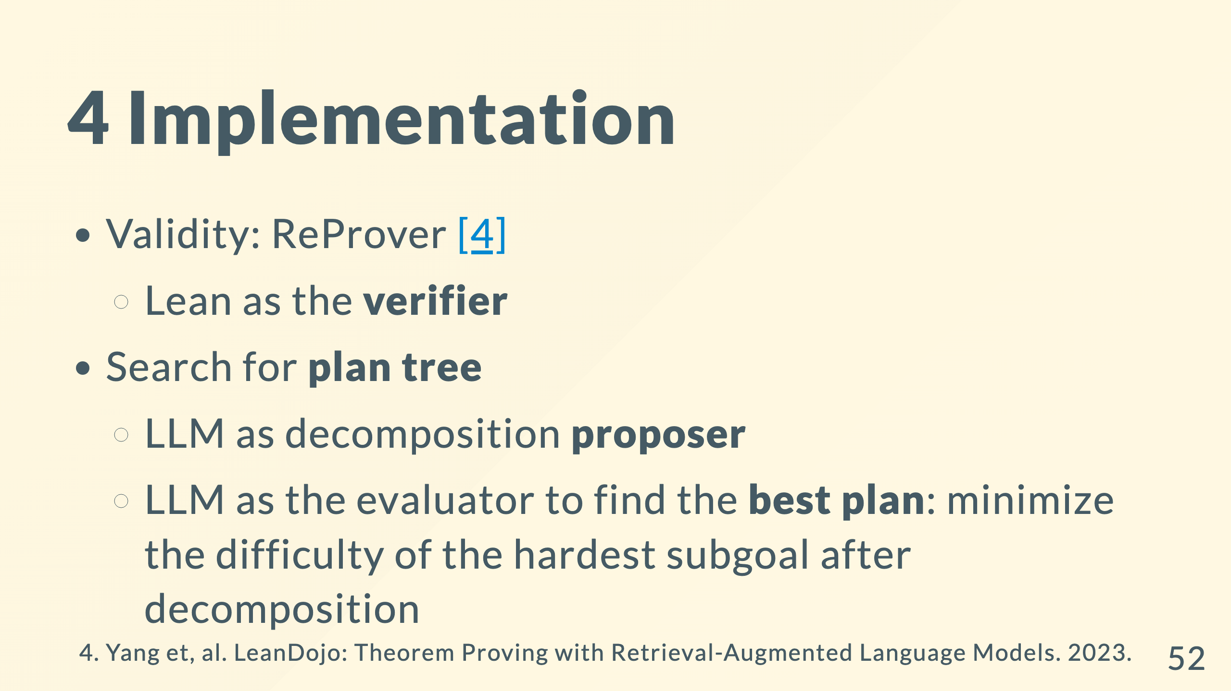

Slide 53


Slide 54


Slide 55


Slide 56


Slide 57


Slide 58


Slide 59


Slide 60


Slide 61


